Slide 1
Thyroid Disorders in Pregnancy : Addressing the Challenges
Dr Hiren Patt
D.M. (Endocrinology)
(K.E.M., Mumbai)

Slide 2
M.B.B.S. – B.J. Medical College, A’bad
M.D. (Medicine) – B.J. medical College, A’bad
D.M. (Endocrinology) – K.E.M. Hospital, Mumbai
My clinic:
Shivranjani cross road, Satellite
Consultant Endocrinologist
K.D.Hospital, A’bad

Slide 3
Thyroid Disorders in Pregnancy : Addressing the Challenges
Dr Hiren Patt
D.M. (Endocrinology)
(K.E.M., Mumbai)

Slide 4
Epidemiology of hypothyroidism in pregnancy
Most common thyroid disorder in pregnancy is maternal hypothyroidism¹
In Western countries:²
Overt hypothyroidism occurs in 0.3% to 0.5% of pregnancies
Subclinical hypothyroidism occurs in 2% to 3% of pregnancies
Study conducted in Mumbai for Asian-Indian population:³
Hypothyroidism in pregnant women is 4.8%
Sahu et al study, 2009⁴
Subclinical hypothyroidism among pregnant women is 6.47%
Overt hypothyroidism is 4.58%
Progression from subclinical hypothyroidism to overt hypothyroidism was seen in 3% to 29% of women with autoimmunity
Banerjee S. Thyroid disorders in pregnancy. J Assoc Physicians India. 2011 Jan;59 Suppl:32-4.
Abalovich M, Amino N, Barbour LA, et al. Management of thyroid dysfunction during pregnancy and postpartum: an Endocrine Society Clinical Practice Guideline. J Clin Endocrinol Metab. 2007 Aug;92(8 Suppl):S1-47.
Nambiar V, Jagtap VS, Sarathi V, et al. Prevalence and impact of thyroid disorders on maternal outcome in asian-indian pregnant women. Journal of Thyroid Research 2011;429097:6.
Sahu MT, Das V, Mittal S, et al. Overt and subclinical thyroid dysfunction among Indian pregnant women and its effect on maternal and fetal outcome. Arch Gynecol Obstet. 2010 Feb;281(2):215-20.
Notes:
Maternal hypothyroidism is the most common thyroid disorder in pregnancy.
In Western countries, it is estimated that overt hypothyroidism occurs in 0.3% to 0.5% of pregnancies and subclinical hypothyroidism occurs in 2% to 3% of pregnancies.
According to a study conducted in Mumbai for Asian-Indian population, the prevalence of hypothyroidism in pregnant women is 4.8%. According to Sahu et al, the prevalence of subclinical hypothyroidism among pregnant women is 6.47% and overt hypothyroidism is 4.58% in Indian population. Progression from subclinical hypothyroidism to overt hypothyroidism is seen in 3% to 29% women with autoimmunity.
References:
Banerjee S. Thyroid disorders in pregnancy. J Assoc Physicians India. 2011 Jan;59 Suppl:32-4.
Autoimmune Thyroid Disease and Pregnancy Follow-up. Emedicine Website. http://emedicine.medscape.com/article/261913-overview. Accessed November 21, 2011.
Nambiar V, Jagtap VS, Sarathi V, et al. Prevalence and impact of thyroid disorders on maternal outcome in asian-indian pregnant women. Journal of Thyroid Research 2011;429097:6.
Sahu MT, Das V, Mittal S, et al. Overt and subclinical thyroid dysfunction among Indian pregnant women and its effect on maternal and fetal outcome. Arch Gynecol Obstet. 2010 Feb;281(2):215-20.

Slide 5
Notes:
The prevalence of hypothyroidism was 15.1%, 12.06%, and 14.36% in the first, second, and third trimester, respectively, whereas anti‑TPO antibody positivity was seen in 18.07%, 19.45%, and 22.91% in each trimester.
Following trimester‑specific TSH cutoffs of <2.5 mIU/L for the first trimester and <3.0 mIU/L for the second and third trimester as suggested by ATA, we found 44.3%, 32.0%, and 34% women were found to have hypothyroidism in the first, second, and third trimester, respectively.
References:
Dhanwal DK, Bajaj S, Rajput R, Subramaniam K, Chowdhury S, Bhandari R, et al. Prevalence of hypothyroidism in pregnancy:
An epidemiological study from 11 cities in 9 states of India. Indian J Endocr Metab 2016;20:387-90.

Slide 6
Screening for Thyroid Disorders in Pregnancy
Part 2

Slide 7
Case 1
28/F,
Primi, 2 MA
Mother – Hypothyroidism
1 year back,
Do we need to screen for hypothyroidism now ?
 | Pt’s | Normal range
TSH | 3.5 | 0.4 – 4
Anti TPO Ab | > 1300 | < 20

Slide 8
Hypothyroidism: Screening Women In Pregnancy Universal Screening: If not feasible
High Risk Group: Must be Screened
H/o: Autoimmune Thyroid Disease
TPO Positivity
Symptoms Positive
Other Auto Immune Disease ( Type 1 Diabetes Mellitus )
F. H. of Auto Immune Disease
Goitre
H/o: Thyroid surgery, I 131 Treatment, Head- Neck irradiation
> 30-35 yrs age
Alex Stagnaro-Green, Thyroid,2011

Slide 9
Universal Vs Selective Case Based Screening for hypothyroidism in pregnancy
Study | Study Design | Sample Size | TSH Cut-Off | % of patients missed with hypothyroidism in pregnancy
Wang et al | Multicenter Cohort Study | Approx 3000 | >4mIU/L | 81.6%
Matsuzek et al | Case-Control Study | 270 | >2.5mIU/L | 46.4%
Goel et al | Prospective Case Control | 1,020 | >2.5mIU/L | 32%
Vaidya et al | Single Centre Case-Control Study | 1,560 | >4.2mIU/L | 30%
Horacek et al | Cross Sectional | 400 | >3.5mIU/L | 55%
1.Meta-analysis has shown that case-based screening can miss up to 49 % of pregnant women with thyroid dysfunction.
2.Further support for advocacy of universal screening methods for thyroid disorders in pregnancy.
Zahra Jouyandeh , Endocrine; 2015

Slide 10
Thyroid evaluation in normal pregnancy
Usual recommendations for thyroid evaluation in normal pregnancy
Recommendation | Indication
TSH and FT4 | Screening Interpretation should be trimester specific
TPO-Ab and Tg-Ab | Presence of autoimmune thyroid disease
Ultrasound | Advisable when nodular disease is suggested by clinical examination
Galofre JC, Davies TF. Autoimmune thyroid disease in pregnancy: a review. J Womens Health (Larchmt). 2009;18(11):1847-1856.
Notes:
Interpretation of thyroid function tests in pregnancy should be trimester specific.
The usual recommended tests for the thyroid function evaluation in normal pregnancy are TSH and free T4.
Measurement TPO-Ab and/or Tg antibody indicates AITD.
Ultrasound scan of thyroid is indicated when a nodular disease is suggested by clinical examination.
References:
Galofre JC, Davies TF. Autoimmune thyroid disease in pregnancy: a review. J Womens Health (Larchmt). 2009;18(11):1847-1856.

Slide 11
Thyroid Physiology in Pregnancy

Slide 12
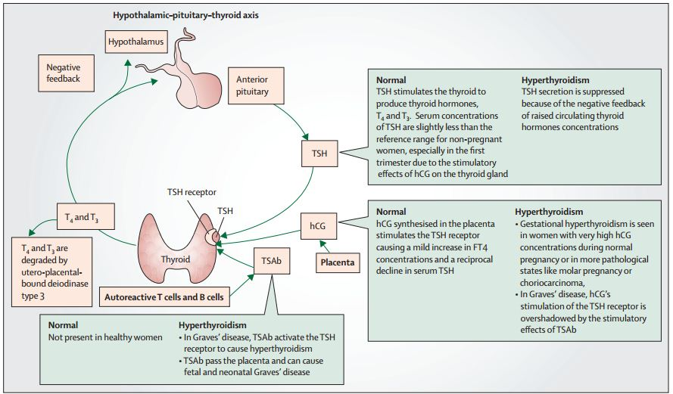
Thyroid physiology in pregnancy¹⁻⁴
Cooper DS, Laurberg P. Hyperthyroidism in pregnancy. Lancet Diabetes Endocrinol. 2013 Nov;1(3):238-49.
Notes:
During pregnancy, several hormonal changes and metabolic demands occur, which lead to intense and complex effects on thyroid function.
Pregnancy-related hyperoestrogenism results in increased glycosylation of TBG, prolonging circulatory half-life of TBG from 15 minutes to 3 days and resulting in increased serum TBG concentration and decreased free thyroid hormone. This eventually leads to an increase in total T4 and T3 production poststimulation of hypothalamic pituitary axis. TBG begins to increase in the first 2 weeks of pregnancy and reaches a plateau by 20 weeks of gestation.
hCG concentration increases during the first trimester of pregnancy, plateaus thereafter during mid-gestation and persists until shortly after delivery. There exists structural similarity between hCG and TSH; hCG has an inherent, weak thyroid stimulating activity and acts on TSH receptor leading to increased production of thyroid hormones and decreased TSH levels. There is a reciprocal relationship between hCG and TSH, that is, a decrease in TSH occurs with an increase in hCG levels; and a linear relationship between free T4 (FT4) and hCG levels.
Increased T4 placental transport and increased thyroid hormone degradation by type III deiodinase also increased thyroid hormone production.
Increased glomerular filtration rate during pregnancy results in sustained rise in renal clearance of iodine and decrease in plasma inorganic iodine concentration. In women with iodine sufficiency, intrathyroidal iodine stores are plentiful and hence there is little impact on thyroid with renal iodine losses. Deficiency of iodine can cause reduced maternal T₄, increased TSH and maternal goitre.

Slide 13
Thyroid Physiology in Pregnancy
Notes:
Figure A shows the peak in HCG during the first trimester of pregnancy and the corresponding dip in the TSH. Figure B shows a corresponding peak in FT3 as the TSH peaks. Figure C shows a parallel rise in both TBG and T4.

Slide 14
Case 1
Patient:
Do I need to take Thyroxine ?
What will happen if I don’t take Thyroxine ?
 | Pt’s | Normal range
TSH | 8 | 0.4 – 4
Total T4 | 15 | 4.5 – 12.5
Total T3 | 230 | 70 - 200
Free T4 | 1.6 | 0.8 – 1.8

Slide 15
Maternal and Neonatal Impact of Thyroid Disorders
Part 3

Slide 16
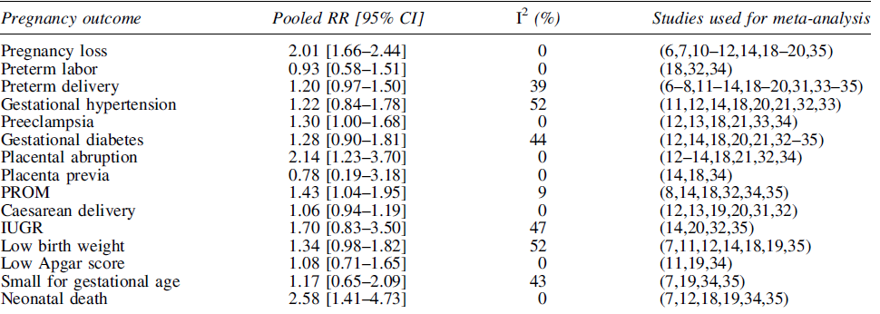
Pooled Relative Risk with 95% Confidence Interval Comparing Pregnant Women with SCH to Pregnant Euthyroid Women for All Pregnancy Outcomes

Slide 17
Children of the women with high TSH:
IQ scores 4 points lower than control
15% had scores of ≤85 (5% control)
IQ scores of children of untreated mothers:
7 points lower than the control
19% had scores of ≤85 (5% control)
After 11 yrs— 64% of the untreated women and only 4% of the control women had confirmed hypothyroidism.
Haddow et al , N Engl J Med 1999;341:549-55
Notes:
Methods
In 1996 and 1997, we measured thyrotropin in stored serum samples collected from 25,216 pregnant women between January 1987 and March 1990. We then located 47 women with serum thyrotropin concentrations at or above the 99.7th percentile of the values for all the pregnant women, 15 women with values between the 98th and 99.6th percentiles, inclusive, in combination with low thyroxine levels, and 124 matched women with normal values.
Their seven-to-nine-year-old children, none of whom had hypothyroidism as newborns, underwent 15 tests relating to intelligence, attention, language, reading ability, school performance, and visual–motor performance.
Results
The children of the 62 women with high serum thyrotropin concentrations performed slightly less well on all 15 tests. Their full-scale IQ scores on the Wechsler Intelligence Scale for Children, third edition, averaged 4 points lower than those of the children of the 124 matched control women (P=0.06); 15 percent had scores of 85 or less, as compared with 5 percent of the matched control children. Of the 62 women with thyroid deficiency, 48 were not treated for the condition during the pregnancy under study. The full-scale IQ scores of their children averaged 7 points lower than those of the 124 matched control children (P=0.005); 19 percent had scores of
85 or less. Eleven years after the pregnancy under study, 64 percent of the untreated women and 4 percent of the matched control women had confirmed hypothyroidism.
Conclusions
Undiagnosed hypothyroidism in pregnant women may adversely affect their fetuses; therefore, screening for thyroid deficiency during pregnancy may be warranted. (N Engl J Med 1999;341:549-55.)

Slide 18
Trimester Specific Reference Ranges in Pregnancy
Part 5

Slide 19
Recommendations from Guidelines on Upper TSH limit during pregnancy
Guidelines | Country of Origin | Trimester specific Ref ranges recommended
ITS Guidelines | India | 1st : 2.5 mIU/L 2nd : 3.0mIU/L 3rd : 3.0 mIU/L
ETA Guidelines | European | 1st : 2.5 mIU/L 2nd : 3.0mIU/L 3rd : 3.0 mIU/L
ATA Guidelines | American | Use locally derived Ref ranges from a specified Pregnant population If not available use locally derived ref ranges from a similar population from another country If the above is also not available use and upper TSH ref limit of 4 .0 mIU/L

Slide 20
Upper limit of TSH in Pregnancy
Initial studies of pregnant women in the United States (U.S.) and Europe first led to recommendations for a TSH upper reference limit of 2.5 mU/L in the first trimester, and 3.0 mU/L in the 2nd and 3rd trimesters .
More recent studies in pregnant women in Asia, India, and the Netherlands, have demonstrated only a modest reduction in the upper reference limit.
2011 ATA:
6 Pregnancy studies with around 5500 subjects
2017 ATA:
Much Larger Cohorts, combines analysis of over 60,000 Subjects
Notes:
These cutoffs were predominantly based on the published reference ranges obtained from six pregnancy studies together comprising a total cohort of approximately 5500 subjects.
Since that publication, additional much larger cohorts have published center- and trimester specific pregnancy reference ranges. These analyses combine data from over 60,000 subjects

Slide 21
ATA Guidelines 2017
Rx is recommended:
TSH > 10 mIU/l
TSH 4-10 mIU/l with Anti TPO Ab +
Rx may be considered for:
TSH 4-10 mIU/l with Anti TPO Ab –
TSH 2.5-4 mIU/l with Anti TPO Ab +
Rx is not recommonded
TSH < 4 mIU/l with Anti TPO Ab -

Slide 22
Case 1
28/F,
2 MA
 | Pt’s | Normal range
TSH | 8 | 0.4 – 4
Total T4 | 15 | 4.5 – 12.5
Total T3 | 230 | 70 - 200
Free T4 | 1.6 | 0.8 – 1.8
Anti TPO Ab | > 1300 | < 20

Slide 23
ATA Guidelines 2017
Rx is recommended:
TSH > 10 mIU/l
TSH 4-10 mIU/l with Anti TPO Ab +
Rx may be considered for:
TSH 4-10 mIU/l with Anti TPO Ab –
TSH 2.5-4 mIU/l with Anti TPO Ab +
Rx is not recommonded
TSH < 4 mIU/l with Anti TPO Ab -

Slide 24
Target TSH Pre-Conception & Post-Conception

Slide 25
Case 2
26/F
Hypothyroidism: 3 yrs, on Thyroxine 50 mcg/day
Patient:
Can I plan the pregnancy now ?
What precautions do I need to take in pregnancy
 | Pt’s | Normal range
TSH | 7.5 | 0.4 – 4
Free T4 | 1.5 | 0.8 – 1.8

Slide 26
ATA Guidelines 2017
Before planning a pregnancy: Target TSH
Low normal
< 2.5
During pregnancy:
Increase the dose: 30 % (2 tab/wk)
Monitor TSH: 4-6 weekly.
Target TSH:
Low normal
< 2.5

Slide 27
Autoimmune Thyroid Disease In Pregnancy
Part 4

Slide 28
Case 2
32/F,
3 MA, H/o: Recurrent miscarraige
Patient:
What are the consequences of high TPO Ab ?
Do I need to take Thyroxine ?
 | Pt’s | Normal range
TSH | 3.5 | 0.4 – 4
Free T4 | 1.6 | 0.8 – 1.8
Anti TPO Ab | >1300 | < 20

Slide 29
Meta analysis of thyroid antibodies and miscarriage risk (19 cohort studies)
4.3 [2.1-8.9]
9 studies
3.1 [2.2-4.4]
7 studies
4.2 [0.97-18.4]
3 studies
Thangaratinam BMJ 2011 342:d2616
Notes:
Evaluate assoc of thyroid Ab and miscarriage in women with nl thyroid func
19 Cohort studies of about 8000 pts overall tripling of odds of miscarriage in presence of thyroid autoantibodies OR 3.9[2.48-6.12] all 19 showed pos association
OR unselected 4.28 (2.06-8.92) 9 studies
OR subfertility undergoing ART 3.15 (2.23-4.44) 7 studies Negro study RCT no difference in preg rates if Ab pos and ART but higher miscarraige
OR recurrent mis 4.22 (0.97-18.44) 3 studies
Similar for case control studies

Slide 30
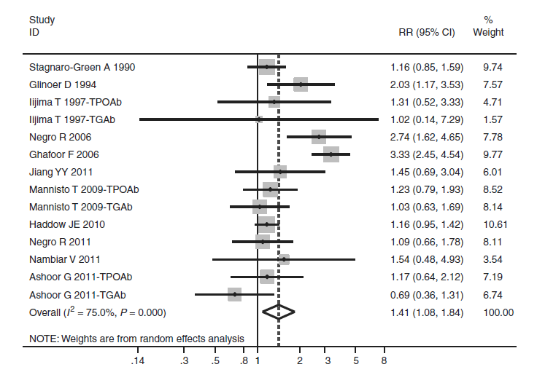
Meta analysis of thyroid antibodies and preterm delivery risk (11 prospective cohort studies)
*
*
*
*
*
*
1.41 [1.08-1.84]
1.98 [1.29-3.04]
X He Eur J Endocrinol 2012 167:455
Notes:
14 indiv data from 11 PROSPECTIVE cohort studies 34657 participants preterm delivery <37-36 wks (14 entries because studies with TPO and Tg Ab listed twice)
Overall RR 1.41, 41% higher for all studies
Significant heterogeneity between studies as 5 included women with thyroid dysfunction and 6 did not.
In fact, status of thyroid function explained 64% of between study variance
Therefore sensitivity analysis performed
For studies excluding women with thyroid dysfnc overall RR for perterm delivery and pos Ab was 1.98 [1.29-3.04]
Strength of association for TPO Ab but if just looked at studies that included thyroid dysfnc, not sig association
Only 1 study reported and analyzed info about potential confounders of age BMI gravidity race smoking gest age, educational level and site Haddow In fact 64% of variablit
Prev of TPO Ab 5.26% to 14.89%
9 with TPO Ab, 3 Tg Ab and 2 with both. Overall combined RR for preterm delivery risk for preg women with pos Ab c/w ref pop was 1.41 (CI 1.08-1.84)
ONLY 6 studies in green excluded women with thyroid dysfunction, all eval TPO AB
However, 5 studies included women with thyroid dysfunc
Therefore significant heterogeneity
New recent study just published in JCEM from Greece (Karakosta) supports that autoimmunity WITHOUT TSH elevation in early pregnancy associated with preterm delivery whereas combination was not

Slide 31
Is there any benefit of treatment with Thyroxine ?

Slide 32
Effect of Rx with LT-4 in Thyroid autoimmunity and miscarriage/Pre-term delivery
115 pregnant TPO Ab+ women, TSH <3, randomized to LT4 Rx or placebo
*P<0.05 vs. others
*
*
LT4 Rx in euthyroid TPOAb+ women ↓ miscarriage & preterm delivery
Negro et al, J Clin Endocrinol Metab, 2006
Notes:
No difference in PIH, Preeclampsia, or abruption

Slide 33
ATA Guidelines 2017
Euthyroid, Anti TPO Ab +
Pregnancy loss
Preterm labour
Rx with T4 (25-50 mcg/day) may be considered (in view of potential benefits compared to minimal risk)

Slide 34
The proportion of women with thyroid antibodies in whom TSH was greater than 3 mU/ L
Notes:
The bars show the proportion of women with thyroid antibodies in whom TSH was greater than 3 mU/ L, as a function of gestational time. The last bar shows TSH determinations obtained 3-4 days after delivery.

Slide 35
T4 Dose Titration

Slide 36
Factors Affecting
Age
Weight
Lean body mass
TSH/Free T4
Pregnancy/OCP: increase 30 %
Etiology of hypothyroidism
Total thyroidectomy (2 – 2.5 mcg/kg/day) > AITD (1.6 – 1.7 mcg/kg/day)

Slide 37
Congenital hypothyroidism
Neonate: 10 – 15 mcg/kg/day
< 1 year: 6 – 10 mcg/kg/day
1-3 years: 4 – 6 mcg/kg/day
3-10 years: 3 – 5 mcg/kg/day
10-18 years: 2 – 4 mcg/kg/day
Adults: 1.6 – 1.7 mcg/kg/day

Slide 38
Factors Affecting
Age
Weight
Lean body mass
TSH/Free T4
Pregnancy/OCP: increase 30 %
Etiology of hypothyroidism
Total thyroidectomy (2 – 2.5 mcg/kg/day) > AITD (1.6 – 1.7 mcg/kg/day)

Slide 39
Examples
34/F
Weight gain (78 -> 86), bodyache
Total Thyroidectomy 6 months back
TSH: > 150 mIU/l
Free T4: low

Slide 40
Example
24/F
Mood changes, bodyache
Wt: 54 kg
TSH: 12 mIU/l
Free T4: Normal

Slide 41
Dosage
Starting dose: 25 – 100 mcg/day
Repeat TSH after 4-6 weeks
Dose adjustments: 12.5 – 25 mcg/day

Slide 42
Thyroxin treatment for hypothyroidism in pregnancy
Average increment in L-Thyroxine dosage in women without residual functional thyroid tissue depends on the initial elevation of serum TSH¹
Serum TSH elevation | Augmented dose of L-Thyroxine
5–10 mIU/L | 25–50 μg/d
10 and 20 mIU/L | 50–75 μg/d
>20 mIU/L | 75–100 μg/d
BMJ dosing:²
First trimester TSH | Start L-Thyroxine
2.5–5 mIU/L | 50 μg/d
5.0–8.0 mIU/L | 75 μg/d
>8 mIU/L | 100 μg/d
De Groot L, Abalovich M, Alexander EK, et al. Management of thyroid dysfunction during pregnancy and postpartum: an Endocrine Society clinical practice guideline. J Clin Endocrinol Metab. 2012 Aug;97(8):2543-65.
Negro R, Stagnaro-Green A. Diagnosis and management of subclinical hypothyroidism in pregnancy. BMJ. 2014 Oct 6;349:g4929.
Notes:
Average increment in L-Thyroxine dosage in women without residual functional thyroid tissue depends on the initial elevation of serum TSH. The table in the slide illustrates L-Thyroxine dose based on serum TSH elevation.
References:
De Groot L, Abalovich M, Alexander EK, et al. Management of thyroid dysfunction during pregnancy and postpartum: an Endocrine Society clinical practice guideline. J Clin Endocrinol Metab. 2012 Aug;97(8):2543-65.

Slide 43
Hyperthyroidism in Pregnancy : Addressing the Challenges
Copyright © 2011 Abbott India Limited. All rights reserved

Slide 44
Effect of Hyperthyroidism on Pregnancy
Untreated severe hyperthyroidism causes a number of menstrual disturbances
Pregnant hyperthyroid women are at a risk of:
Miscarriage
Abortions
Still births
Intrauterine growth restriction (IUGR)
Premature labor
Neonatal hyperthyroidism
Perinatal mortality
Pregnant women with mild hyperthyroidism on treatment have good outcomes
Uncontrolled disease may result in thyroid crisis (storm) or heart failure during delivery
Zainuddin Z, Shaker AAH. The Family Physician. 2005;13(3).
Notes:
In cases of severe hyperthyroidism before pregnancy, if the patient is not adequately treated, she may be at the risk of infertility due to nonovulation and irregular menstrual cycles. If the patient becomes pregnant and is left untreated, miscarriage, abortions, still births, intrauterine growth restriction (IUGR), premature labor, neonatal hyperthyroidism, and perinatal mortality are some of the complications that may arise.¹(/p3/col1/para1)
Adequately treated pregnant women with mild hyperthyroidism have good outcomes and the fetus is generally not affected by the disease.
As mentioned earlier, severe untreated situations may result in complications, sometimes resulting in a thyroid crisis or heart failure especially during delivery.¹(/p3/col1/para1)
Reference
Zainuddin Z, Shaker AAH. Hyperthyroidism in Pregnancy. The Family Physician. 2005;13(3):2-4.

Slide 45
Hyperthyroidism
Increased secretion of thyroid hormones
Causes of Hyperthyroidism
Toxic diffuse goiter (Graves’ disease)
Toxic adenoma
Toxic multinodular goiter (Plummer’s disease)
Painful subacute thyroiditis
Silent thyroiditis, including lymphocytic and postpartum thyroiditis
Iodine-induced hyperthyroidism
Excessive pituitary TSH or trophoblastic disease
Excessive ingestion of thyroid hormones¹
HCG-associated transient thyrotoxicosis²
1. Baskin HJ, et al. Endocr Pract. 2002;8(6):457-469.
2. Rodien P. Hum Reprod Update. 2004;10(2):95-105.
Notes:
To begin with, let’s discuss the causes and salient features of hyperthyroidism.
Hyperthyroidism occurs due to an increased secretion (overproduction) of thyroid hormones. It is caused due to several reasons, including toxic diffuse goiter, also known as Graves’ disease; toxic adenoma; toxic multinodular goiter, also known as Plummer’s disease; painful subacute thyroiditis; silent thyroiditis, including lymphocytic and postpartum thyroiditis; iodine-induced hyperthyroidism; excessive pituitary thyroid stimulating hormone (TSH) or trophoblastic disease; and excessive ingestion of thyroid hormones.¹(/p458/col2/para5) (/p459/col1/para1)
Both invitro and invivo studies have proved the thyrotrophic activity of HCG. (/p95/col1/para3;/col2/para1) It is reported that peak levels of HCG are invariably related to suppressed TSH levels. ²(/p96/col1/para1) Increase in thyroid hormone under the influence of hCG is associated with decreased TSH levels. This causes transient thyrotoxicosis. ²(/p96/col2/para3)
References
1. Baskin HJ, Cobin RH, Duick DS, et al. American Association of Clinical Endocrinologists medical guidelines for clinical practice for the evaluation and treatment of hyperthyroidism and hypothyroidism. Endocr Pract. 2002;8(6):457-469.
2. Rodien P, Jordan N, Lefevre A, et al. Abnormal stimulation of the thyrotrophin receptor during gestation. Hum Reprod Update. 2004;10(2):95-105.

Slide 46
Case 4
24/F
2 MA
Asymptomatic
No goiter
 | Pt’s | Normal range
TSH | 0.01 | 0.4 – 4
Free T4 | 1.5 | 0.8 – 1.8

Slide 47
Management ?
Rx: Antithyroid drugs
Tc99 Thyroid scan
TSH receptor Antibody
USG Thyroid

Slide 48
Management ?
Rx: Antithyroid drugs
Tc99 Thyroid scan
TSH receptor Antibody
USG Thyroid

Slide 49
Management ?
Rx: Antithyroid drugs
Tc99 Thyroid scan
TSH receptor Antibody: Negative
USG Thyroid

Slide 50
Management ?
Wait & watch
Reason:
Diagnosis: Gestational thyrotoxicosis due to hCG (not Grave’s disease)
Common in the 1st trimester
Recover by 12-16 weeks of gestation

Slide 51
Follow up: 20 weeks
 | Pt’s | Normal range
TSH | 0.01 | 0.4 – 4
Free T4 | 1.5 | 0.8 – 1.8

Slide 52
Why ?
USG: Twin pregnancy
Twin pregnancy: high hCG
Wait & watch: bcz Free T4 is normal

Slide 53
Case 5
24/F
2 MA
Toxic Symptoms
Mild goiter
TSH R Ab: Positive
 | Pt’s | Normal range
TSH | 0.01 | 0.4 – 4
Free T4 | 2.6 | 0.8 – 1.8

Slide 54
Management ?
Rx:
1st Trimester – PTU
2nd /3rd Trimester – CMZ/MMZ
Monitor Free T4, TSH every 4 weekly
Target
TSH: Normal
Free T4: High Normal (upto 20 % higher than ULN)

Slide 55
Effect of Pregnancy on Graves’ Disease
Aggravated symptoms of Graves’ disease during the 1st trimester due to increased hCG production
Thyrotoxicosis improves in the 2nd & 3rd trimester of pregnancy
Postpartum, symptoms increase due to a sudden rise in the level of TSH receptor stimulating antibodies
Reduction of TSH receptor stimulating antibody levels during pregnancy improves symptoms of Graves’ disease
1st trimester
2nd trimester
3rd trimester
Post-partum
Notes:
During pregnancy, the natural immunosuppression that occurs in the mother improves thyrotoxicosis. This is more prevalent in the second and third trimesters. The antibody levels that are generally high in Graves’ disease, fall to a level that considerably improves the symptoms of Graves’ disease. However, these changes are only seen in the second and third trimester. In the first trimester and postpartum, there may be sudden spurts of symptoms of Graves’ disease. This occurs because in the first trimester, there is an increase in hCG production, which may lead to a sudden outburst of symptoms, and in postpartum due to a rise in the levels of TSH receptor stimulating antibodies, the symptoms of Graves’ disease appear again. (/p2/col2/para3)
Reference
Zainuddin Z, Shaker AAH. Hyperthyroidism in pregnancy. The Family Physician. 2005;13(3):2-4.

Slide 56
Postpartum Thyroiditis

Slide 57
Postpartum thyroiditis
In the first postpartum year
Manifestations:
Transient hyperthyroidism
Transient hypothyroidism
Transient hyperthyroidism followed by permanent hypothyroidism
Stagnaro-Green A. Clinical review 152: postpartum thyroiditis. J Clin Endocrinol Metab. 2002;87(9):4042-4047.
Notes:
PPT is an inflammatory thyroid disorder that usually occurs during the first postpartum year, and it is manifested as transient hyperthyroidism, transient hypothyroidism or as hyperthyroidism followed by transient hypothyroidism.
This condition is caused due to a reversal of the partial immunosuppression caused by pregnancy, resulting in an intensification or worsening of the underlying autoimmune thyroiditis.
References:
Stagnaro-Green A. Clinical review 152: postpartum thyroiditis. J Clin Endocrinol Metab. 2002;87(9):4042-4047.

Slide 58
PPT: 2017 Guidelines
Thyrotoxic phase:
Beta-blockers for symptoms
ATDs are not recommended
Monitor serum TSH approximately 4–6 weeks
Hypothyroid phase: Treat if
Symptomatic
Lactating
Planning a pregnancy
Alexander EK, Pearce EN, Brent GA, et al. 2017 Guidelines of the American Thyroid Association for the Diagnosis and Management of Thyroid Disease During Pregnancy and the Postpartum. Thyroid. 2017 Mar;27(3):315-389.

Slide 59
Case 3
30 yrs/F
5 months postpartum
Asymptomatic
 | Pt’s | Normal range
TSH | 0.001 | 0.4 – 4
Free T4 | 1.4 | 0.8 – 1.8

Slide 60
Management ?
ATDs
Tc99 Thyroid scan
TSH R Ab
USG

Slide 61
Management ?
ATDs
Tc99 Thyroid scan
TSH R Ab
USG

Slide 62
Management ?
ATDs
Tc99 Thyroid scan
TSH R Ab: Negative
USG

Slide 63
Management ?
Wait & Watch
 | 1st visit | > 1 month
TSH | 0.001 | 0.8
Free T4 | 1.4 | 1.2

Slide 64
Management ?
Wait & Watch
 | 1st visit | > 1 month | > 2 months
TSH | 0.001 | 0.8 | 26
Free T4 | 1.4 | 1.2 | 1.2

Slide 65
Management ?
Wait & Watch
 | 1st visit | > 1 month | > 2 months | > 4 months
TSH | 0.001 | 0.8 | 26 | 3
Free T4 | 1.4 | 1.2 | 1.2 | 1.3

Slide 66
> 2 years
Weight gain ~ 4 kg
Generalised weakness
 | Pt’s | Normal range
TSH | 50 | 0.4 – 4
Free T4 | 1.1 | 0.8 – 1.8

Slide 67
Predicting the Risk

Slide 68
19 years old, 6 MA
TSH 12
Anti-TPO : 1300 IU/l
Hashimotos thyroiditis
Doctor, what are the chances of my daughter/boy
getting HT?
When should I bring them for evaluation?

Slide 69
Prevalence
Risk to family members (KEM study):
Offspring: 16 %
Siblings: 32 %
Parents: 30 %
Prevalence
Adult population: 3.9 % (RK Marwah et al)

