Slide 1
Thyroid Disorders: Management Issues
- Dr. Hiren Patt
D.M. (Endocrinology)
(K.E.M., Mumbai)

Slide 2
Management Issues
T4 dose titration: how & when ?
Subclinical Hypothyroidism: When to treat ?
Thyroid disorders in Pregnancy: how to manage ?

Slide 3
T4 Dose Titration

Slide 4
Factors Affecting
Age
Weight
Lean body mass
TSH/Free T4
Pregnancy/OCP: increase 30 %
Etiology of hypothyroidism
Total thyroidectomy (2 – 2.5 mcg/kg/day) > AITD (1.6 – 1.7 mcg/kg/day)

Slide 5
Congenital hypothyroidism
Neonate: 10 – 15 mcg/kg/day
< 1 year: 6 – 10 mcg/kg/day
1-3 years: 4 – 6 mcg/kg/day
3-10 years: 3 – 5 mcg/kg/day
10-18 years: 2 – 4 mcg/kg/day
Adults: 1.6 – 1.7 mcg/kg/day

Slide 6
Factors Affecting
Age
Weight
Lean body mass
TSH/Free T4
Pregnancy/OCP: increase 30 %
Etiology of hypothyroidism
Total thyroidectomy (2 – 2.5 mcg/kg/day) > AITD (1.6 – 1.7 mcg/kg/day)

Slide 7
Examples
34/F
Weight gain (78 -> 86), bodyache
Total Thyroidectomy 6 months back
TSH: > 150 mIU/l
Free T4: low

Slide 8
Example
24/F
Mood changes, bodyache
Wt: 54 kg
TSH: 12 mIU/l
Free T4: Normal

Slide 9
Dosage
Starting dose: 25 – 100 mcg/day
Repeat TSH after 6 weeks
Dose adjustments: 12.5 – 25 mcg/day
Cardiac disease: start low, go slow

Slide 10
Target TSH

Slide 11
Target values for Serum TSH

Slide 12
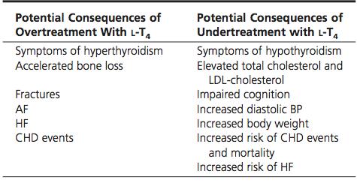
Consequences of Over & Under-treatment:

Slide 13
Changing the brands may lead to fluctuating TSH levels
Hence, it should be avoided whenever possible.

Slide 14
Unusually High T4 requirement

Slide 15
Case
28/F,
Hypothyroidism – 5 years
Wt – 50 kg
Persistently elevated TSH levels
Thyroxin dose (mcg/day) | TSH
100 | > 150
150 | > 150
200 | 100
300 | 80
500 | 100

Slide 16
What could be the reason?
Compliance
Malabsorption (celiac disease/IBD/lactose intolerance)
Atrophic gastritis/H.pylori infection
Hemangioma/GIST/fibroblastic tumors

Slide 17
What could be the reason ?
Food intake
Dietary fiber
Espresso coffee
Ferrous sulphate
Calcium carbonate
PPI
Antacids
Sevelamer
Cholestyramine
Orlistat
Raloxifene

Slide 18
Previous Case
USG Abdomen:
Liver Hemagioma (3 cm * 4 cm)

Slide 19
Treatment Dilemmas: To Treat or not ?

Slide 20
Subclinical & Overt Hypothyroidism
Subclinical hypothyroidism
TSH: > 4.5 mIU/L
Free T4: normal
Overt hypothyroidism
TSH: > 4.5 mIU/L
Free T4: low

Slide 21
Subclinical Hypothyroidism When to treat ?

Slide 22
Case 1
26/F
Bodyache, mood swings
Weight: 60 kg
h/o infertility, planning ART
TSH: 6 mIU/L (normal: 0.4-4)
Free T4: normal

Slide 23
Case 2
26/F
Bodyache, mood swings
Weight: 60 kg
TSH: 6 mIU/L (normal: 0.4-4)
Free T4: normal

Slide 24
Case 3
70/F
Weight: 60 kg
TSH: 6 mIU/L (normal: 0.4-4)
Free T4: normal

Slide 25
Which patient requires treatment ?
Ans.: Case 1
Reason: infertility, Planning ART
Target: keep TSH < 2.5 mIU/L before ART

Slide 26
What about Case 2
26/F
Bodyache, mood swings
Weight: 60 kg
TSH: 6 mIU/L (normal: 0.4-4)
Free T4: normal

Slide 27
Answer
Treat with T4
Repeat TSH, TPO Ab > 3 months
If no symptomatic improvement:
stop the treatment
Wait & watch
Monitor: TSH, Free T4

Slide 28
What about Case 3 ?
70/F
Weight: 60 kg
TSH: 6 mIU/L (normal: 0.4-4)
Free T4: normal

Slide 29
Answer
Wait & watch
Repeat: TSH, Free T4, TPO Ab after 3 months
Reason: TSH increases with age & weight

Slide 30
Learning Points
TSH > 10 mIU/L: treat
TSH: 4.5 – 10 mIU/L with
Symptoms of hypotyroidism
Goitre
Hemithyroidectomy
Pregnancy
Anti TPO Ab +

Slide 31
Thyroid Disorders in pregnancy

Slide 32
Notes:
The prevalence of hypothyroidism was 15.1%, 12.06%, and 14.36% in the first, second, and third trimester, respectively, whereas anti‑TPO antibody positivity was seen in 18.07%, 19.45%, and 22.91% in each trimester.
Following trimester‑specific TSH cutoffs of <2.5 mIU/L for the first trimester and <3.0 mIU/L for the second and third trimester as suggested by ATA, we found 44.3%, 32.0%, and 34% women were found to have hypothyroidism in the first, second, and third trimester, respectively.
References:
Dhanwal DK, Bajaj S, Rajput R, Subramaniam K, Chowdhury S, Bhandari R, et al. Prevalence of hypothyroidism in pregnancy:
An epidemiological study from 11 cities in 9 states of India. Indian J Endocr Metab 2016;20:387-90.

Slide 33
Universal Vs Selective Case Based Screening for hypothyroidism in pregnancy
Study | Study Design | Sample Size | TSH Cut-Off | % of patients missed with hypothyroidism in pregnancy
Wang et al | Multicenter Cohort Study | Approx 3000 | >4mIU/L | 81.6%
Matsuzek et al | Case-Control Study | 270 | >2.5mIU/L | 46.4%
Goel et al | Prospective Case Control | 1,020 | >2.5mIU/L | 32%
Vaidya et al | Single Centre Case-Control Study | 1,560 | >4.2mIU/L | 30%
Horacek et al | Cross Sectional | 400 | >3.5mIU/L | 55%
1.Meta-analysis has shown that case-based screening can miss up to 49 % of pregnant women with thyroid dysfunction.
2.Further support for advocacy of universal screening methods for thyroid disorders in pregnancy.
Zahra Jouyandeh , Endocrine; 2015

Slide 34
Consensus : Indian Guideline on the Management of Maternal Thyroid disorders
All pregnant females should be screened at 1st antenatal visit by measuring TSH levels (IIa/B).
RV Jayakumar, ITS Guidelines for Maternal Thyroid Dysfunction , 2012.

Slide 35
Hypothyroidism: Screening Women In Pregnancy Universal Screening: If not feasible
High Risk Group: Must be Screened
H/o: Autoimmune Thyroid Disease
TPO Positivity
Symptoms Positive
Other Auto Immune Disease ( Type 1 Diabetes Mellitus )
F. H. of Auto Immune Disease
Goitre
H/o: Thyroid surgery, I 131 Treatment, Head- Neck irradiation
> 30-35 yrs age
Alex Stagnaro-Green, Thyroid,2011

Slide 36
Why Do We Need to Treat Thyroid Disorders in Pregnancy ?

Slide 37
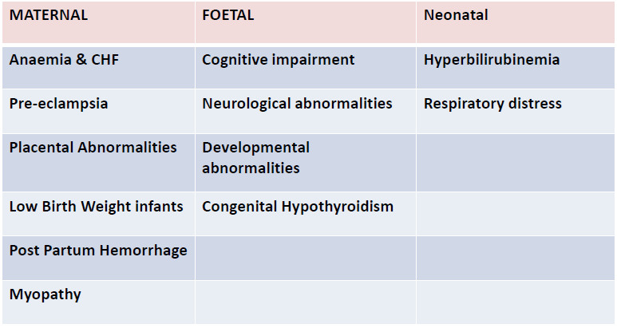
Challenge: Complications of Hypothyroidism in Pregnancy
R V Jayakumar guidelines for Management of thyroid disorder in pregnancy 2012
Notes:
Hypothyroidism in pregnancy affects the general health of the mother, resulting in anemia, congestive heart failure, and antepartum depression. During the course of gestation, it can lead to complications in both the mother and fetus. Hypothyroidism can cause eclampsia, preeclampsia, gestational hypertension, and placental abruption in the mother, and growth restriction and increased perinatal mortality in the fetus. During delivery, it can give rise to increased chances of cesarean section, preterm delivery, or miscarriage of the fetus. Long-term complications in the mother include postpartum depression, postpartum hypertension, and lactation problems, and impaired neuropsychointellectual development in the fetus.¹
Reference
R V Jayakumar guidelines for Management of thyroid disorder in pregnancy 2012

Slide 38
ATA Guidelines 2017
Rx is recommended:
TSH > 10 mIU/l
TSH 4-10 mIU/l with Anti TPO Ab +
Rx may be considered for:
TSH 4-10 mIU/l with Anti TPO Ab –
TSH 2.5-4 mIU/l with Anti TPO Ab +
Rx is not recommonded
TSH < 4 mIU/l with Anti TPO Ab -

Slide 39
Recommendations from Guidelines on Upper TSH limit during pregnancy
Guidelines | Country of Origin | Trimester specific Ref ranges recommended
ITS Guidelines | India | 1st : 2.5 mIU/L 2nd : 3.0mIU/L 3rd : 3.0 mIU/L
ETA Guidelines | European | 1st : 2.5 mIU/L 2nd : 3.0mIU/L 3rd : 3.0 mIU/L
ATA Guidelines | American | Use locally derived Ref ranges from a specified Pregnant population If not available use locally derived ref ranges from a similar population from another country If the above is also not available use and upper TSH ref limit of 4 .0 mIU/L

Slide 40
Upper limit of TSH in Pregnancy
Initial studies of pregnant women in the United States (U.S.) and Europe first led to recommendations for a TSH upper reference limit of 2.5 mU/L in the first trimester, and 3.0 mU/L in the 2nd and 3rd trimesters .
More recent studies in pregnant women in Asia, India, and the Netherlands, have demonstrated only a modest reduction in the upper reference limit.
2011 ATA:
6 Pregnancy studies with around 5500 subjects
2017 ATA:
Much Larger Cohorts, combines analysis of over 60,000 Subjects
Notes:
These cutoffs were predominantly based on the published reference ranges obtained from six pregnancy studies together comprising a total cohort of approximately 5500 subjects.
Since that publication, additional much larger cohorts have published center- and trimester specific pregnancy reference ranges. These analyses combine data from over 60,000 subjects

Slide 41
Target TSH
TSH < 2.5 mU/L

Slide 42
Hyperthyroidism in Pregnancy

Slide 43
Effect of Pregnancy on Graves’ Disease
Aggravated symptoms of Graves’ disease during the 1st trimester due to increased hCG production
Thyrotoxicosis improves in the 2nd & 3rd trimester of pregnancy
Postpartum, symptoms increase due to a sudden rise in the level of TSH receptor stimulating antibodies
Reduction of TSH receptor stimulating antibody levels during pregnancy improves symptoms of Graves’ disease
1st trimester
2nd trimester
3rd trimester
Post-partum
Notes:
During pregnancy, the natural immunosuppression that occurs in the mother improves thyrotoxicosis. This is more prevalent in the second and third trimesters. The antibody levels that are generally high in Graves’ disease, fall to a level that considerably improves the symptoms of Graves’ disease. However, these changes are only seen in the second and third trimester. In the first trimester and postpartum, there may be sudden spurts of symptoms of Graves’ disease. This occurs because in the first trimester, there is an increase in hCG production, which may lead to a sudden outburst of symptoms, and in postpartum due to a rise in the levels of TSH receptor stimulating antibodies, the symptoms of Graves’ disease appear again. (/p2/col2/para3)
Reference
Zainuddin Z, Shaker AAH. Hyperthyroidism in pregnancy. The Family Physician. 2005;13(3):2-4.

Slide 44
Case
24/F
8 weeks of gestation
Asymptomatic
TSH: 0.01 (normal: 0.1 – 2.5)
Free T4: normal
Free T3: normal

Slide 45
Management ?
Rx: Antithyroid drugs
Tc99 Thyroid scan
TSH receptor Antibody
USG Thyroid

Slide 46
Management ?
Rx: Antithyroid drugs
Tc99 Thyroid scan
TSH receptor Antibody
USG Thyroid

Slide 47
Management ?
Rx: Antithyroid drugs
Tc99 Thyroid scan
TSH receptor Antibody: Negative
USG Thyroid

Slide 48
Management ?
Wait & watch
Reason:
Diagnosis: Gestational thyrotoxicosis due to hCG (not Grave’s disease)
Common in the 1st trimester
Recover by 12-16 weeks of gestation

Slide 49
Follow up: 20 weeks
TSH: 0.01
Free T4: Normal
Free T3: Normal

Slide 50
Why ?
USG: Twin pregnancy
Twin pregnancy: high hCG
Wait & watch: bcz Free T4 is normal

Slide 51
Case
24/F
8 weeks of gestation
Asymptomatic
TSH: < 0.01 (normal: 0.1 – 2.5)
Free T4: High
Free T3: High
TSH R Ab: Positive

Slide 52
Management ?
Rx:
1st Trimester – PTU
2nd Trimester – CMZ/MMZ
Monitor Free T4, TSH every 4 weekly
Target
TSH: Normal
Free T4: High Normal (upto 20 % higher than ULN)

Slide 53
Effect of Pregnancy on Graves’ Disease
Aggravated symptoms of Graves’ disease during the 1st trimester due to increased hCG production
Thyrotoxicosis improves in the 2nd & 3rd trimester of pregnancy
Postpartum, symptoms increase due to a sudden rise in the level of TSH receptor stimulating antibodies
Reduction of TSH receptor stimulating antibody levels during pregnancy improves symptoms of Graves’ disease
1st trimester
2nd trimester
3rd trimester
Post-partum
Notes:
During pregnancy, the natural immunosuppression that occurs in the mother improves thyrotoxicosis. This is more prevalent in the second and third trimesters. The antibody levels that are generally high in Graves’ disease, fall to a level that considerably improves the symptoms of Graves’ disease. However, these changes are only seen in the second and third trimester. In the first trimester and postpartum, there may be sudden spurts of symptoms of Graves’ disease. This occurs because in the first trimester, there is an increase in hCG production, which may lead to a sudden outburst of symptoms, and in postpartum due to a rise in the levels of TSH receptor stimulating antibodies, the symptoms of Graves’ disease appear again. (/p2/col2/para3)
Reference
Zainuddin Z, Shaker AAH. Hyperthyroidism in pregnancy. The Family Physician. 2005;13(3):2-4.

Slide 54
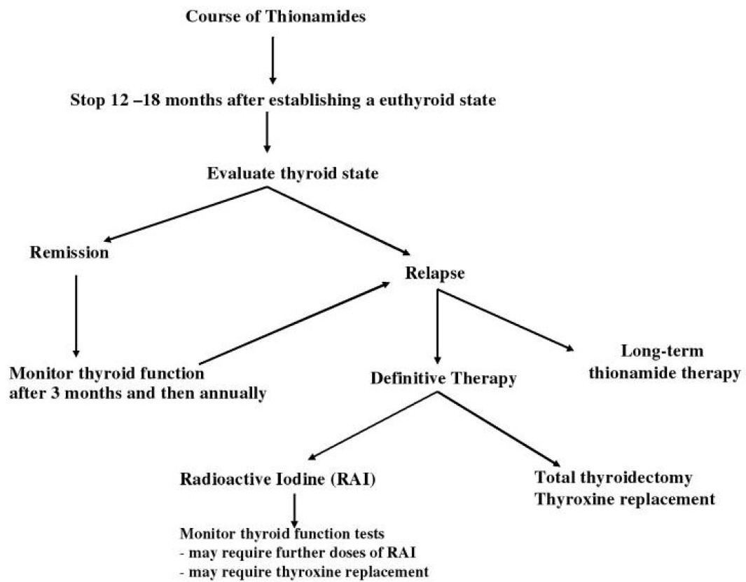
Treatment Algorithm For Grave’s Disease

Slide 55
Recurrent Miscarraige & Thyroid Antibodies

Slide 56
ATA Guidelines 2017
Euthyroid, Anti TPO Ab +
Pregnancy loss
Preterm labour
Rx with T4 (25-50 mcg/day) may be considered (in view of potential benefits compared to minimal risk)

Slide 57
Sick Euthyroid Syndrome: When to Treat ?

Slide 58
Case
60/M
Septic shock, ICU
TSH: 0.6 (normal: 0.4 – 4)
T4: 4.6 mcg/dl (normal: 4.5 – 12.5)
T3: 50 ng/dl (normal: 75 – 200)
Diagnosis: Sick euthyroid syndrome
Treat with T4??

Slide 59
To treat or not ?
No prospective studies
No evidence of benefit/harm of Rx with TH
Some experts recommend Rx, especially in those with low Free T4 / high TSH
Some expert recommend wait & watch & repeat TFT after recovery from illness

Slide 60
Importance of T4

Slide 61
Case
26/F, 1.5 years postpartum
Weakness, weight loss (62 -> 56)
TSH: 6.5 mIU/L (normal: 0.4 – 4)
Free T4: 0.6 (normal: 0.8 – 1.8)
T.LT4 (25 mcg)/day

Slide 62
2 Months Later
TSH: 7.5 mIU/L
Weight loss (56 -> 52)
T.LT4 (50 mcg/day)

Slide 63
Cortisol: 0.6 mcg/dl (normal: 5 - 25)
MRI (pituitary): Empty sella
Tab.Wysolon (2.5 mg) / day
3 months later,
Weight: 52 - > 57

Slide 64
Case
24/F
Symptoms of hypothyroidism
TSH: 0.5 mIU/L (normal: 0.4 – 4)
What next ?
Free T4: 0.6 mcg/dl (normal: 0.8 – 1.8)
Diagnosis: central hypothyroidism

Slide 65
Dietary and Environmental Goitrogens/Thyroid Disruptors

Slide 66
Interferes with
Iodide transporter
TH synthesis
TH secretion
TH action

Slide 67
Thiocynate | Casava, cabbage, cauliflower, smoking
Perchlorate | Fireworks, fertilizers, wheat, wine, beer, multivitamins, cow’s milk
Nitrate | Fertilizer, preservative
Polychlorinated bisphenol | Electrical equipment
Bisphenol A | Food containers, water bottles
Triclosan | Soap, toothpaste, plastic, fabric,
Isoflavons | Soy products, peas, beans, nuts, coffee, tea
Styrene | Plastic, rubber, resins, building materials, automobile exhausts

Slide 68
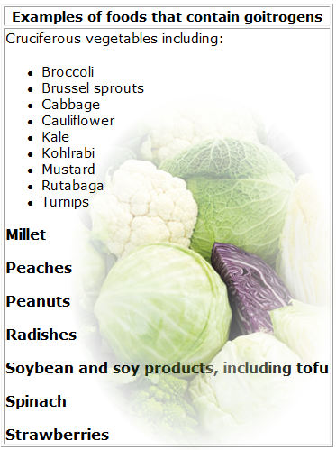
Myth or Realty

Slide 69
Most goitrogens are likely to be clinically relevant only if dietary iodine supply is limited and/or goitrogen intake is high and prolonged

Slide 70
Case 1
60 yrs/F,
Altered sensorium: 2 days
Hypoglycemia, but no improvement even after correction
K/c/o: Hypothyroidism: 10-12 years
Stopped Rx: 1 year
P: 60/min, BP: 80/40 mm Hg

Slide 71
Biochemistry
 |  | Normal range
TSH | 0.08 | 0.4 – 4
T4 | 0.4 | 4.5 – 12.5
Na | 130 | 135 – 145
Rx: Thyroxine 50 mcg/day &
referred to us

Slide 72
Provisional Diagnosis
Myxoedema crisis with panhypopituitarism
(TSH + ACTH deficiency)
Pituitary Profile:
ACTH, Cortisol, FSH, Prolactin
Inj. Hydrocortisone 100 mg i.v. stat and then 8 hourly started

Slide 73
Pituitary Profile
 |  | Normal range
ACTH | 6 | 18-46
S.Cortisol | 0.8 | 5-25
FSH | NDT | > 10
Prolactin | 0.2 | 5-20
MRI: Empty sella

Slide 74
Final Diagnosis
TSH deficiency
ACTH deficiency
FSH/LH deficiency
Prolactin deficiency
Myxoedema crisis + Pahypopituitarism

Slide 75
Management: Issues
T4 & T3 (i.v.): Not available
T4 (oral): Only option
T4: Dose ?

Slide 76
Management
Tab.Thyroxine (400 mcg) stat through RT
No RT feeds for next 4 hours to improve absorption

Slide 77
Management
Day | Tab.Thyroxine | Free T4 (normal range: 0.8-1.8)
1 | 400 mcg | 0.4
2 | 300 mcg | 0.7
3 | 250 mcg | 0.9
4 | 150 mcg | 1.0
5 | 150 mcg | 1.2
6 | 100 mcg | 1.2

Slide 78
Discharged:
Tab. Thyroxine 100 mcg 1-0-0
Tab. Prednisolone 2.5 mg 1-0-0 with stress cover

