Slide 1
Real World Evidence with Gemigliptin
Dr Hiren Patt
D.M. (Endocrinology)

Slide 2
Case 1

Slide 3
48 years/F, IT Professional
DM – 3 yrs,
Generalised weakness
Osmotic symptoms
Tingling in the extremities

Slide 4
Rx: Metfomin + SGLT2i (2 yrs back)
Genital infection, Stopped taking allopathic Rx
Tried alternative Rx/Yoga/home remedies
Sugars – never uncontrolled

Slide 5
Strong F/h/o: DM
BMI: 28 kg/m2
AN +
BP: 130/70 mm Hg
Diagnosis: Uncontrolled Type 2 DM

Slide 6
Investigations
FBS | 180
PPBS | 280
HbA1c | 9.5
Creat | 0.7
LDL – C | 90

Slide 7
ADA/EASD Joint Position Statement: Patient and disease factors that influence glycemic targets
Approach to the management of hyperglycemia
Patient / disease features
More stringent
HbA1c 7%
Less stringent
Risks potentially associated with hypoglycemia and other drug adverse effects
Low
High
Disease duration
Newly diagnosed
Long-standing
Life expectancy
Long
Short
Usually not modifiable
Few / mild
Important comorbidities
Absent
Severe
Few / mild
Established vascular complications
Absent
Severe
Patient attitude and expected treatment efforts
Highly motivated, adherent, excellent self-care capacities
Less motivated, non-adherent, poor self-care capacities
Potentially modifiable
Resources and support system
Readily available
Limited
Inzucchi SE, et al. Diabetes Care 2015;38:140–9

Slide 8
ADA/EASD Joint Position Statement: Patient and disease factors that influence glycemic targets
Approach to the management of hyperglycemia
Patient / disease features
More stringent
HbA1c 7%
Less stringent
Risks potentially associated with hypoglycemia and other drug adverse effects
Low
High
Disease duration
Newly diagnosed
Long-standing
Life expectancy
Long
Short
Usually not modifiable
Few / mild
Important comorbidities
Absent
Severe
Few / mild
Established vascular complications
Absent
Severe
Patient attitude and expected treatment efforts
Highly motivated, adherent, excellent self-care capacities
Less motivated, non-adherent, poor self-care capacities
Potentially modifiable
Resources and support system
Readily available
Limited
Inzucchi SE, et al. Diabetes Care 2015;38:140–9

Slide 9
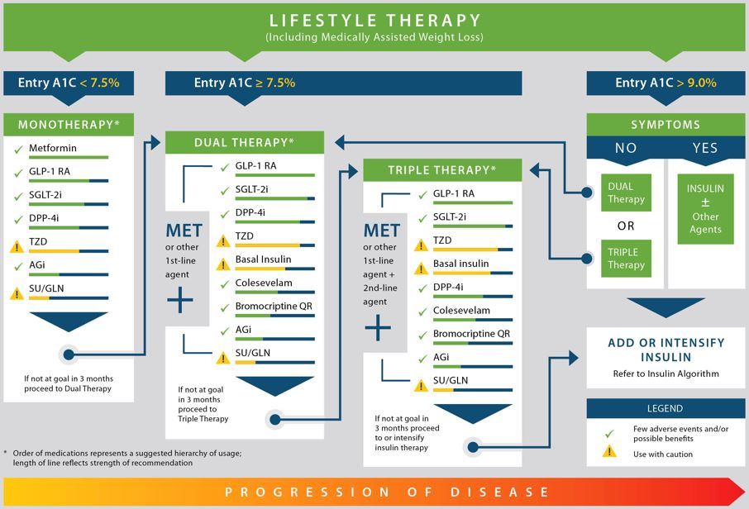
AACE/ACE algorithm¹

Slide 10
What next ?
GLP-1 RA: Not affording
SGLT2i: h/o genital infection
SU: risk of hypo
DPP4i: ideal choice

Slide 11
Gemigliptin 50 mg/day + Metformin 1.5 gm/day
After 20 days
After 3 months
FBS | 116
PPBS | 154
HbA1c | 6.6

Slide 12
Case 2

Slide 13
56/M, Bank Manager
DM: 10 yrs,
Metformin 2 gm/day + Glimiperide 2 mg/day
H/o: toe amputation
BMI: 32 kg/m2
AN +

Slide 14
Investigations
FBS | 110
PPBS | 220
HbA1c | 8
Creat | 0.6
LDL – C | 90

Slide 15
What next ?
GLP-1 RA: Not affording
SGLT2i: h/o toe amputation
SU: risk of hypo
DPP4i or AGI: ideal choice

Slide 16
Gemigliptin 50 mg/day added
LSM advised
After 20 days
After 3 months
FBS | 104
PPBS | 158
HbA1c | 6.3

Slide 17
Case 3

Slide 18
67 yrs/M
DM: 15 yrs,
CKD: 2 yr,
Metformin 1 gm/day + Glipizide 2.5 mg 1-0-1
Recurrent night time Hypoglycemia: 3 months

Slide 19
Investigations
FBS | 64
PPBS | 168
HbA1c | 5.4
eGFR | 42

Slide 20
Glipizide: stopped
After 10 days:
FBS | 86
PPBS | 210

Slide 21
What next ?
SU: risk of hypo
Metformin: CKD (eGFR < 45)
SGLT2i: CKD (eGFR < 45)
Short acting Insulin analoges: Not willing for Insulin
DPP4i or AGI: Option

Slide 22
Gemigliptin: 50 mg/day
After 20 days
FBS | 80
PPBS | 136

Slide 23
Thank you

