Slide 1
Obesity & Management
Dr Hiren Patt
D.M. (Endocrinologist)

Slide 2
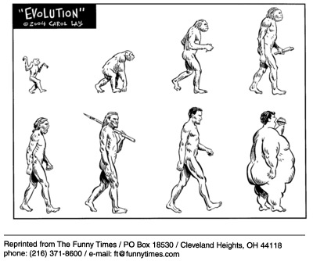
OBESITY

Slide 3
Prevalence
WHO projected in 2015, approximately 2.3 billion adults will be overweight and more than 700 million were obese.
At least 20 million children under the age of 5 years were overweight globally

Slide 4
Is Obesity a Disease?

Slide 5
Obesity is a heterogeneous complex disorder of multiple
etiologies characterized by excess body fat that threatens or affects socioeconomic, mental or physical health
Obesity is a multiple organ disorder, affecting 9 organ systems involving over 40 conditions…..

Slide 6
Table 1 Classification of Overweight and Obesity by Body Mass Index (BMI),Waist Circumference, and Associated Disease Risk
 | BMI (kg/m²) | Obesity Class | Disease Risk (Relative to Normal Weight and Waist Circumference)*
 |  |  | Men: ≤40 inches (≤102 cm) Women: ≤35 in (≤88 cm) | > 40 inches (>102 cm) > 35 inches (>88 cm)
Underweight | < 18.5 |  | — | —
Normal weight | 18.5–24.9 |  | — | —
Overweight | 25.0–29.9 |  | Increased | High
Obesity | 30.0–34.9 | I | High | Very high
 | 35.0–39.9 | II | Very high | Very high
Extreme obesity | ≥ 40 | III | Extremely high | Extremely high
* Disease risk for type-2 diabetes, hypertension, and cardiovascular disease. ‡ Increased waist circumference can also be a marker for increased risk even in persons of normal weight. Adapted from Obesity: Preventing and Managing the Global Epidemic. WHO, 1997.3

Slide 7
Obesity-related organ systems review
Cardiovascular
Hypertension
Congestive heart failure
Cor pulmonale
Varicose veins
Pulmonary embolism
Coronary artery disease
Respiratory
Dyspnea
Obstructive sleep apnea
Hypoventilation syndrome
Pickwickian syndrome
Asthma
Endocrine
Metabolic syndrome
Type 2 diabetes
Dyslipidemia
Polycystic ovarian syndrome/angrogenicity
Amenorrhea/infertility/menstrual disorders
Notes:
Adapted from Kushner RF, Roth JL. Assessment of the obese patient. Endocrinol Metab Clin North Am 2003;32:924

Slide 8
Obesity-related organ systems review
Gastrointestinal
Gastroesophageal reflux disease
Non-alcoholic fatty liver disease
Cholelithiasis
Hernias
Colon cancer
Musculoskeletal
Hyperuricemia and gout
Immobility
Osteoarthritis (knees and hips)
Low back pain
Genitourinary
Urinary stress incontinence
Obesity-related glomerulopathy
Chronic kidney disease
Hypogonadism (male)
Breast and uterine cancer
Pregnancy complications

Slide 9
Obesity-related organ systems review
Psychologic
Depression/low self esteem
Body image disturbance
Reduced quality of life
Neurologic
Stroke
Idiopathic intracranial hypertension
Meralgia paresthetica
Integument
Striae distensae (stretch marks)
Stasis pigmentation of legs
Lymphedema
Cellulitis
Intertrigo, carbuncles
Acanthosis nigricans/skin tags

Slide 10
Is there any cure for Obesity?

Slide 12
LIFESTYLE MANAGEMENT
Diet therapy
Physical Activity therapy
Behavioral change
Results in a modest (typically 3–5 kg) weight loss compared with no treatment or usual care

Slide 13
Diet Therapy
Reduce overall consumption of calories
Smaller portion sizes
Eating more fruits and vegetables
Consuming more whole grain cereals
Selecting leaner cuts of meat and skimmed dairy products
Reducing fried foods and other added fats and oils
Drinking water instead of caloric beverages

Slide 14
Diet Therapy
Low-carbohydrate diets:
Institute of Medicine ►45% to 65% calories from carbohydrates
Lower-carbohydrate diets ► 40% to 46%
Atkins diet ► 5% to 15% carbohydrate
.

Slide 15
Diet Therapy
Meal Replacements:
Shakes, Meal bars, or Selected frozen meals.
Provides 200 - 400 calories
Helps to reduce calories from the total day and provide a nutritionally balance meal when combined with a side of vegetables and fruits (provides adequate fiber and antioxidants).
Convenient and Reasonably Priced.
Effective and healthy option for busy people who make poor food choices.

Slide 16
Diet Therapy
Energy density:
Number of calories (energy) a food contains per unit of weight.
People tend to ingest a constant volume of food, regardless of caloric or macronutrient content.
Diets containing low energy dense foods control hunger and result in decreased caloric intake and weight loss.
Examples : soups, fruits, vegetables, oatmeal, and lean meats.
Dry foods and high-fat foods, such as pretzels, cheese, egg yolks, potato chips, and red meat, have a high energy density.

Slide 17
Diet Therapy
Very-low-calorie diets:
A form of more aggressive dietary therapy.
Promotes a rapid and significant (13–23 kg) short-term weight loss over a 3- to 6-month period.
These are usually prescribed by physicians specializing in obesity care because of the need for close metabolic monitoring.

Slide 18
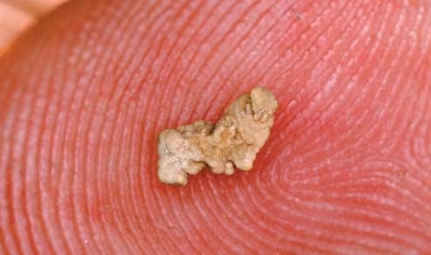
Diet Therapy
Concerns have been raised that diets focusing long term on eating mostly
protein with small amounts of carbohydrate may increase the risk of
osteoporosis and kidney stones????

Slide 19
Physical Activity Therapy
Focusing on simple ways to add physical activity into the normal daily routine through leisure activities, travel, and domestic work should be suggested.
Examples:
Walking
Using the stairs
Doing home and yard work
Engaging in sport activities

Slide 20
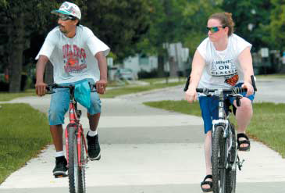
Physical Activity Therapy
The Dietary Guidelines for Americans 2005 found compelling evidence that At least 60 to 90 minutes of daily moderate-intensity physical activity (420–630 min/wk) is needed to sustain weight loss.

Slide 21
Behavioral Therapy
Motivational Interviewing
Cognitive behavioral therapy
Self Monitoring
Identifying internal triggers for eating
Creation of coping strategies
Prompts or reminders can help to build better habits
Stress management
Stimulus Control
Social Support
Problem Solving

Slide 22
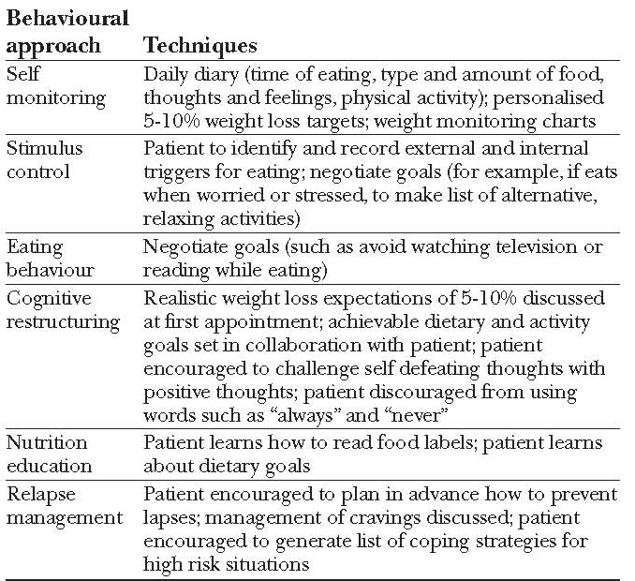
Examples of commonly used Behavioral modification Techniques

Slide 23
PHARMACOTHERAPY
Centrally Acting Anorexiant Medications
Sibutramine, Phentermine
Peripherally Acting Medication
Orlistat
THE ENDOCANNABINOID SYSTEM
Rimonabant (Banned in many countries, due increased suicidal risks)
The effectiveness of antiobesity drugs is enhanced when they are prescribed with lifestyle modification because of the importance of a drug-behavior interaction.

Slide 24
SURGERY
For severe obesity (BMI 40 kg/m2) or for moderate obesity (BMI 35 kg/m2) with a serious medical condition.
Weight loss surgeries:
Restrictive:
Ex: Vertical Banded Gastroplasty & LASGB
Restrictive Malabsorptive:
Ex: Roux-en-Y gastric bypass (RYGB) & Biliopancreatic diversion
Notes:
LASGB = Laparoscopic adjustable silicone gastric banding

Slide 25
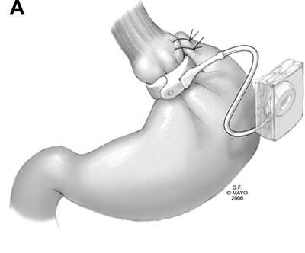
SURGERY
Laparoscopic adjustable silicone gastric banding (LASGB):
LAP-BAND, the first banding device,
was approved in US in 2001.
The diameter of this band is adjustable
Injection or removal of saline into the
reservoir tightens or loosens the band’s
internal diameter, changing the size of
the gastric opening.
No risk for developing micronutrient
deficiencies
Notes:
LASGB = Laparoscopic adjustable silicone gastric banding

Slide 26
SURGERY
Roux-en-Y gastric bypass (RYGB)
‘‘Roux-en-Y’’ refers to Y-shaped section of small intestine created by the surgery; the Y is created at the point where the pancreobiliary conduit (afferent limb) and the Roux (efferent) limb are connected. ‘‘Bypass’’ refers to the exclusion or bypassing of the distal stomach, duodenum, and proximal jejunum.
Most commonly performed.
Performed with open incision or laparoscopically.
Notes:
LASGB = Laparoscopic adjustable silicone gastric banding

Slide 27
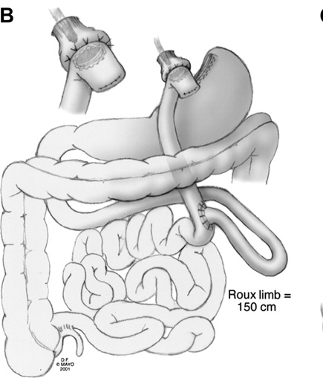
SURGERY
Involves formation of a 10- to 30-mL proximal gastric pouch by either surgically separating or stapling the stomach across the fundus. Outflow from the pouch is created by performing a narrow (10 mm) gastrojejunostomy. The distal end of jejunum is then anastomosed 50 to 150 cm below the gastrojejunostomy.

Slide 28
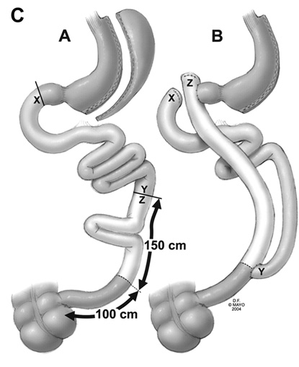
SURGERY
Biliopancreatic Diversion
More complicated and less commonly performed.
Involves a subtotal gastrectomy, leaving
a much larger gastric pouch
Small bowel is divided 250 cm proximal
to the ileocecal valve and connected
directly to the gastric pouch, producing a gastroileostomy.
The remaining proximal limb
(biliopancreatic conduit) is then
anastomosed to the side of the distal ileum 50 cm proximal to the ileocecal valve.

Slide 29
Biliopancreatic diversion with duodenal switch:
A variation of the biliopancreatic diversion, which preserves the first portion of the duodenum.
A vertical subtotal gastrectomy is performed and the duodenum is divided just beyond the pylorus.
The distal small bowel is connected to the short stump of the duodenum, producing a 75- to 100-cm ileal-duodenal common channel for absorption of nutrients. The other end of the duodenum is closed, and the remaining small bowel connected onto the enteral limb at about 75 to 100 cm from the ileocecal valve.

Slide 30
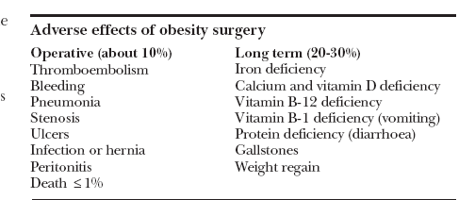

Slide 31
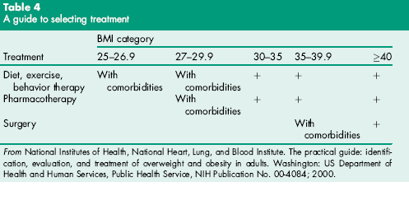
Selection of Therapy

Slide 32
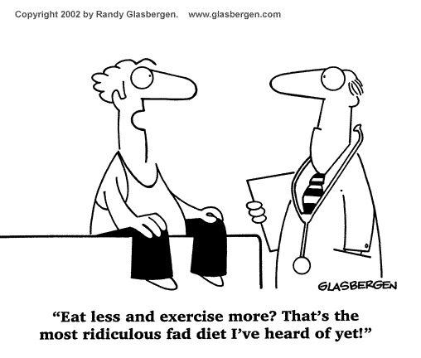
The Magic Formula

Slide 33
Imprisoned in every fat man, a thin one is wildly signaling to be let out.
I am not my body. My body is nothing without me
Thank You

