Slide 1
Metformin in GDM

Slide 2
Case Capsule
26 yrs/F, Referred by gynecologist,
2 months pregnancy, primigravida
HbA1c – 6.6,
OGTT (2 hrs) –165 mg/dl
FBS – 102

Slide 3
On further evaluation…
Pre pregnancy BMI – 26 kg/m2
Father – Type 2 DM
No h/o DM before pregnancy
No Bad Obstratric History

Slide 5
1. What is the diagnosis ?
GDM
OR
Pre-GDM
2. How to screen for DM in 1st trimester ?
FBS alone
OR
OGTT (75 gm/100 gm/50 gm)

Slide 6
3. What cut off we need to take ?
IADPSG
DIPSI
ADA
ACOG

Slide 7
GDM v/s Pre-GDM
Pre-GDM:
DM diagnosed in the 1st trimester
GDM:
DM diagnosed in 2nd/3rd trimester
ADA 2017 Guidelines

Slide 8
1st trimester:
Insulin sensitivity: Increases
2nd/3rd trimester:
Insulin sensitivity: Decreases
GDM

Slide 9
Screening for DM in 1st trimester
Standard criteria for DM as in nonpregnant state
FBS + HbA1c/OGTT (75 gm)
ADA 2017 Guidelines

Slide 10
Diagnosis of GDM

Slide 11
Carpenter/Coustan
100 gm OGTT
Fasting
Any 2 abnormal values
F – 95
1 hr – 180
2 hr – 155
3 hr - 140
Based on Risk of DM in future
No relation with adverse maternal/fetal outcome in pregnancy

Slide 12
ACOG criteria (2 step)
50 gm OGTT
Random
1 hr – 140
100 gm OGTT
Fasting
Any 2 abnormal values
F – 95
1 hr – 180
2 hr – 155
3 hr - 140

Slide 13
IADPSG criteria (1 step)
75 gm OGTT
Fasting
Any 1 abnormal value
F – 92
1 hr – 180
2 hr – 153
Based on adverse pregnancy outcomes
Problem: over-diagnosis of GDM

Slide 14
ADA Guidelines 2017
1 step (IADPSG)
Or
2 step (ACOG)

Slide 15
Back to Case
She was started on MNT
Advised for SMBG at home for 1 week
Post prandial > 140 (always)

Slide 17
5. What next ?
Metformin ?
Insulin ??
Acarabose ??
6. What are the data for Metformin in GDM ?

Slide 18
7. Metformin v/s Insulin in GDM
8. If any one needs insulin, then which & what regime?
9. How to manage type 2 DM during lactation ?

Slide 19
Supports use of Metformin in GDM
IJEM Mar-Apr 2015 / Vol 19 | Issue 2

Slide 20
Several RCTs, meta‑analysis and observational studies have largely supported the outcome with metformin.
Ease of its use, acceptability by the patients, significantly less maternal weight gain and less maternal hypoglycemia, as evident from these studies, appears a lot encouraging.
Moreover, two years follow up of offspring in MIG‑TOFU, also reassures no anticipated harm and in fact suggests its beneficial effects in offspring.
IJEM Mar-Apr 2015 / Vol 19 | Issue 2

Slide 21
Positive outcomes in pregnant PCOD with metformin use even during the first trimester, almost rules out the remaining ounce of potential harm in terms of any potential teratogenic effect.
The emerging clinically equivalent safety and efficacy data of metformin compared to insulin, it appears that it may perhaps open a rather new door in managing GDM.
IJEM Mar-Apr 2015 / Vol 19 | Issue 2

Slide 22
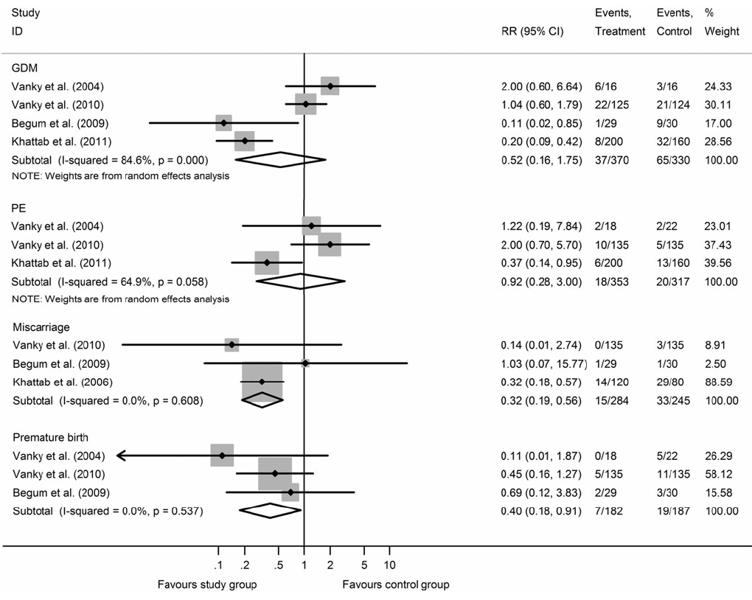
Efficacy of Metformin on Pregnancy Complications in PCOS Patients: Forest Plots
Metformin therapy throughout pregnancy can reduce the RR of miscarriage and premature birth incidence in PCOS patients with no serious side effects.
Gynecol Endocrinol. 2015;31(11):833-9

Slide 23
A meta-analysis of 11 RCTs were performed to compare the effects of metformin with insulin on maternal and neonatal outcomes in GDM.
Results :
There was no significant difference of the effect on maternal outcomes between the two treatments in HbA1c,FPG, and the incidence of preeclampsia.
Whereas, significantly reduced results were found in the metformin group in PIH rate (RR = 0.53), average weight gains after enrollment (MD = -1.28, P\0.0001), and average gestational ages at delivery (MD = 0.94, P = 0.03).
Regarding neonatal outcomes, when compared with insulin group, metformin presented significantly lower average birth weights (MD = -44.35 ,P = 0.04), incidence of hypoglycemia (RR = 0.69) and neonatal intensive care unit(NICU) (RR = 0.82).
Conclusion : Metformin can significantly reduce several adverse maternal and neonatal outcomes including PIH rate, incidence of hypoglycemia and NICU, thus it may be an effective and safe alternative or additional treatment to insulin for GDM women
Arch Gynecol Obstet. 2015 Jul;292(1):111-20.

Slide 24
Could Metformin Manage Gestational Diabetes Mellitus instead of Insulin
International Journal of Reproductive Medicine Volume 2016, Article ID 3480629

Slide 25
Precautions to be taken while Prescribing Metformin in GDM
Information to the patient that it is not an approved indication.
Although metformin is not approved for use in pregnancy, its use as an adjunct therapy in GDM has been considered by several organizations.
To be written on the prescription that patient has agreed to take metformin after having explained the same

Slide 26
Insulin
Basal
Detemir
NPH
Short acting
Regular
Lispro
Aspart

Slide 27
Target SMBG
F – 95
1 hr – 140
2 hr – 120

Slide 28
DM in lactational period
Glyburide/Glipizide/Metformin/Insulin:
Minimal excretion in breast milk
Safe to use
Acarbose/DPP4 inhibitors
Not yet studied
Probably compatible

