Slide 1
Insulin Injection Techniques

Slide 2
Ideal Treatment
Regular injection
Proper dose
Proper method

Slide 3
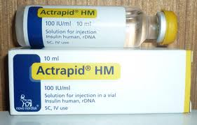
Types of Injection

Slide 4
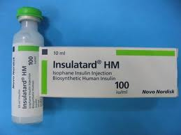
Types of Injection

Slide 5
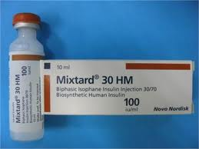
Types of Injection

Slide 6
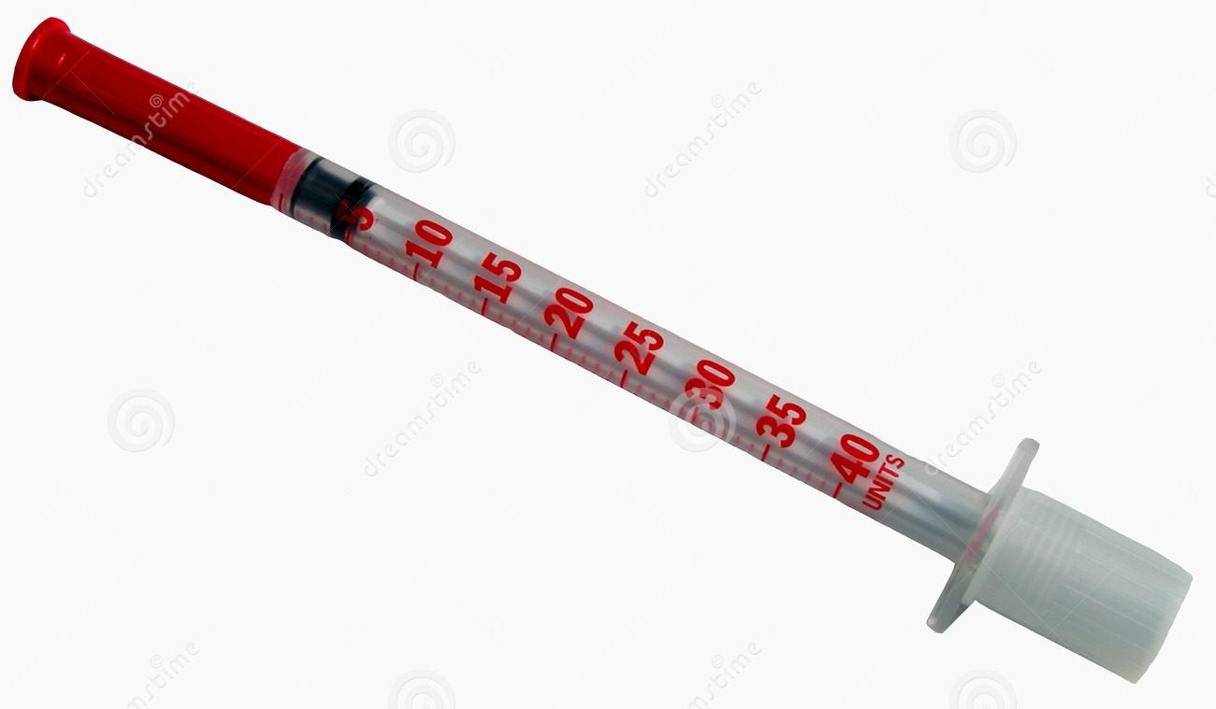
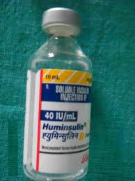
Types of Syringe

Slide 7
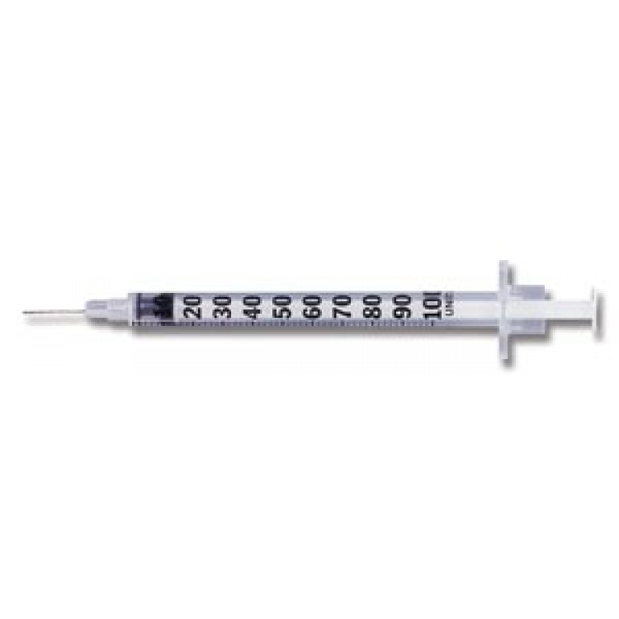
Types of Syringe

Slide 8
Insulin Injection Technique

Slide 9
Insulin Injection Technique

Slide 10
Insulin Injection Technique

Slide 11
Insulin Injection Technique

Slide 12
Insulin Injection Technique

Slide 13
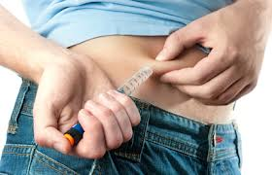
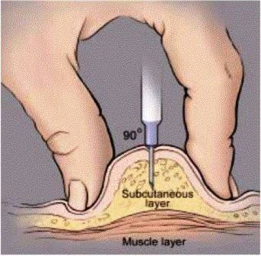
Insulin Injection Technique

Slide 14
Insulin Injection Technique

Slide 15
Insulin Mixing

Slide 16
Time of Insulin Injection
30 minutes before food
Morning: before breakfast
Evening: Before dinner

Slide 17
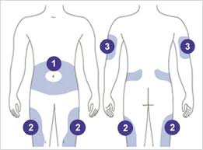
Insulin Injection Sites

Slide 18
Insulin Storage
Freeze: Till expiry date
At room Temperature: 1 month

Slide 19
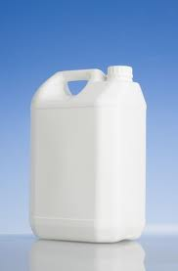
Syringe Disposal

Slide 20
Reuse of Insulin Syringe?

Slide 21

लहान मुलांना कधी शिकवाल ?

