Slide 1
Hyperthyroidism: Challenges in The Management
Dr Hiren Patt
Consultant Endocrinologist,
K.D. Hospital, A’bad.

Slide 2
Case 1
57 yrs/M,
Weight gain,
Generalised weakness
 | Pt’s | Normal range
TSH | 0.1 | 0.4 – 4
Total T4 | 1.2 | 4.5 – 12.5

Slide 3
Rx: Carbimazole
No improvement
 | Pt’s | Normal range
TSH | 0.01 | 0.4 – 4
Total T4 | 0.9 | 4.5 – 12.5

Slide 4
Diagnosis
Secondary Hypothyroidism (Hypopituitarism)

Slide 5
Key Message
“Low TSH” means “Hyperthyroidism” = Not always

Slide 6
Hyperthyroidism
Increased secretion of thyroid hormones
Causes of Hyperthyroidism
Toxic diffuse goiter (Graves’ disease)
Toxic adenoma
Toxic multinodular goiter (Plummer’s disease)
Painful subacute thyroiditis
Silent thyroiditis, including lymphocytic and postpartum thyroiditis
Iodine-induced hyperthyroidism
Excessive pituitary TSH or trophoblastic disease
Excessive ingestion of thyroid hormones¹
HCG-associated transient thyrotoxicosis²
1. Baskin HJ, et al. Endocr Pract. 2002;8(6):457-469.
2. Rodien P. Hum Reprod Update. 2004;10(2):95-105.
Notes:
To begin with, let’s discuss the causes and salient features of hyperthyroidism.
Hyperthyroidism occurs due to an increased secretion (overproduction) of thyroid hormones. It is caused due to several reasons, including toxic diffuse goiter, also known as Graves’ disease; toxic adenoma; toxic multinodular goiter, also known as Plummer’s disease; painful subacute thyroiditis; silent thyroiditis, including lymphocytic and postpartum thyroiditis; iodine-induced hyperthyroidism; excessive pituitary thyroid stimulating hormone (TSH) or trophoblastic disease; and excessive ingestion of thyroid hormones.¹(/p458/col2/para5) (/p459/col1/para1)
Both invitro and invivo studies have proved the thyrotrophic activity of HCG. (/p95/col1/para3;/col2/para1) It is reported that peak levels of HCG are invariably related to suppressed TSH levels. ²(/p96/col1/para1) Increase in thyroid hormone under the influence of hCG is associated with decreased TSH levels. This causes transient thyrotoxicosis. ²(/p96/col2/para3)
References
1. Baskin HJ, Cobin RH, Duick DS, et al. American Association of Clinical Endocrinologists medical guidelines for clinical practice for the evaluation and treatment of hyperthyroidism and hypothyroidism. Endocr Pract. 2002;8(6):457-469.
2. Rodien P, Jordan N, Lefevre A, et al. Abnormal stimulation of the thyrotrophin receptor during gestation. Hum Reprod Update. 2004;10(2):95-105.

Slide 7
Management
Conservative (wait & watch)
Thyroiditis
Gestational Thyrotoxicosis
Medical management
Grave’s disease
Multinodular goiter with toxicosis

Slide 8
How to Differentiate
Tc99 Thyroid Scan
TSH Receptor Antibody

Slide 9
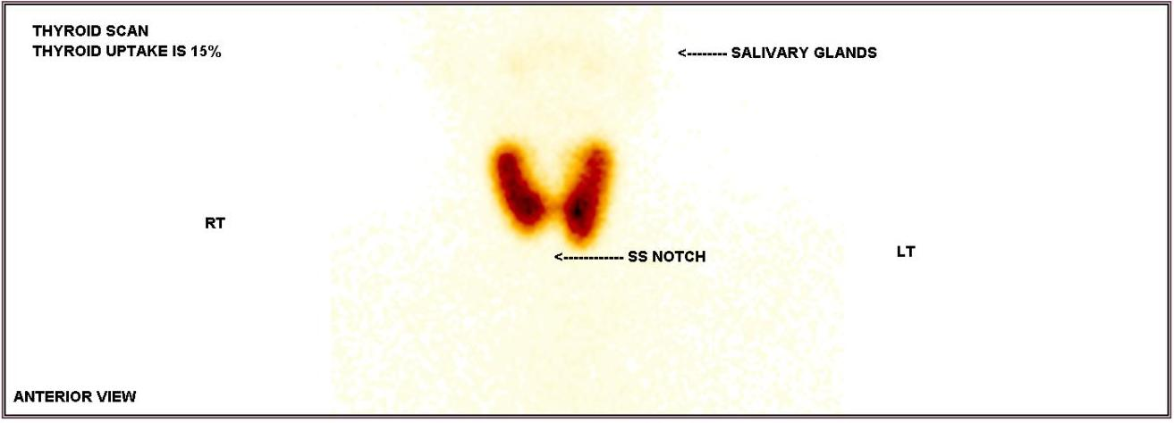
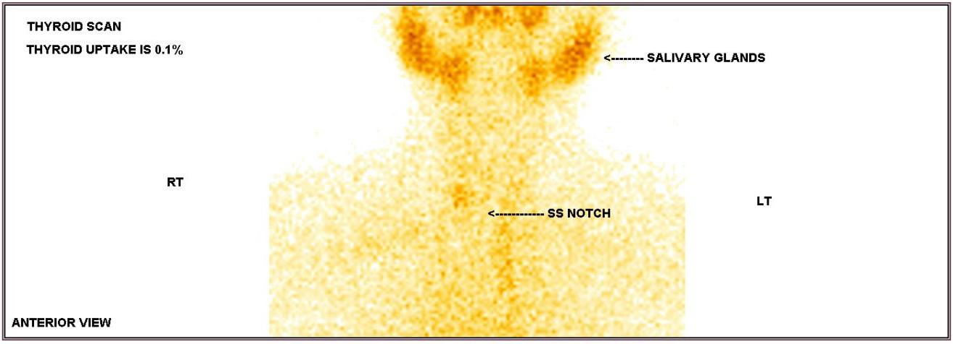

Slide 10
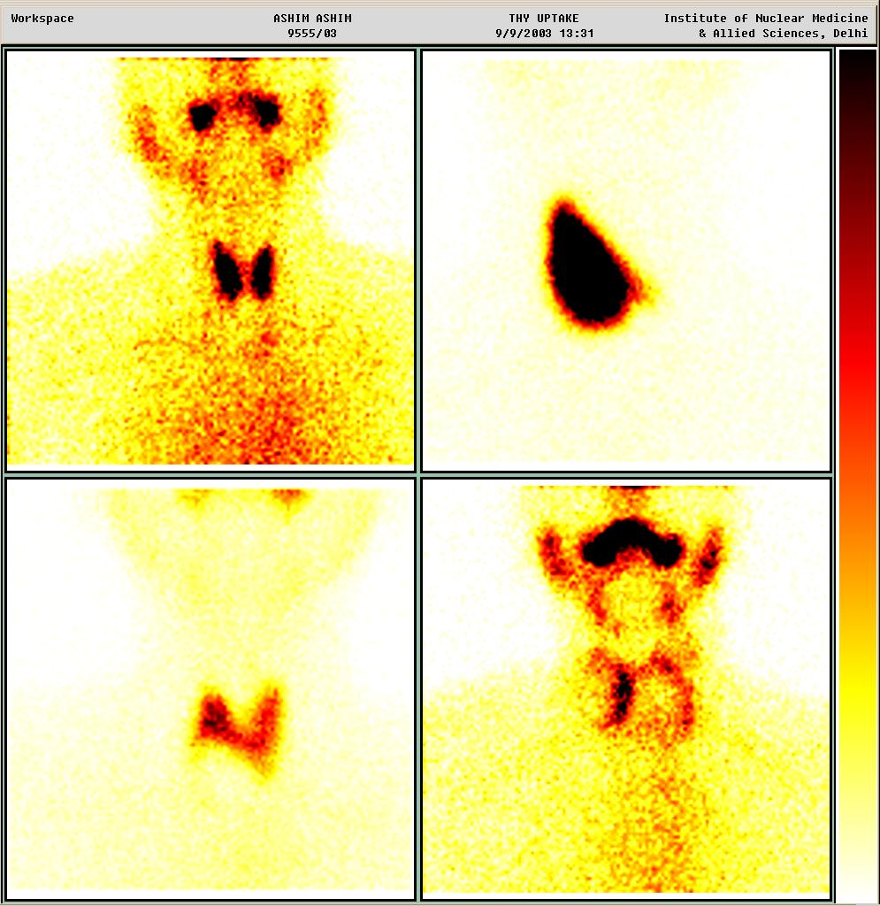

Slide 11
Case 1
32 yrs/F
Toxic symptoms: 10 days
SevereThroat pain, fever: 10 days
No goiter
 | Pt’s | Normal range
TSH | 0.01 | 0.4 – 4
Total T4 | 12.8 | 4.5 – 12.5

Slide 12
Management ?
Rx: Antithyroid drugs
USG Thyroid
Tc99 Thyroid scan
TSH receptor Antibody

Slide 13
Management ?
Rx: Antithyroid drugs
USG Thyroid
Tc99 Thyroid scan
TSH receptor Antibody

Slide 14
Management
Diagnosis: Thyroiditis
Treatment: Analgesics or steroids (if no response to analgesics)
> 2 months
 | Pt’s | Normal range
TSH | 2.3 | 0.4 – 4
Total T4 | 6.8 | 4.5 – 12.5

Slide 15
Grave’s Disease

Slide 16
Management
Anti thyroid drugs: CMZ/MMZ
RAI (Radio active iodine)
Thyroidectomy

Slide 17
Case 2
36 yrs/F
Toxic symptoms: 6 months
Weight loss ~ 3 kg
Mild diffuse goiter
 | Pt’s | Normal range
TSH | 0.01 | 0.4 – 4
Total T4 | 12.8 | 4.5 – 12.5
Total T3 | 230 | 60 – 200

Slide 18
Case 3
36 yrs/F
Toxic symptoms: 6 months
Weight loss ~ 10 kg
Large diffuse goiter
 | Pt’s | Normal range
TSH | < 0.001 | 0.4 – 4
Total T4 | > 30 | 4.5 – 12.5
Total T3 | > 800 | 60 – 200

Slide 19
Management ?

Slide 20
Case 2
36 yrs/F
Toxic symptoms: 6 months
Weight loss ~ 3 kg
Mild diffuse goiter
 | Pt’s | Normal range
TSH | 0.01 | 0.4 – 4
Total T4 | 12.8 | 4.5 – 12.5
Total T3 | 230 | 60 – 200

Slide 21
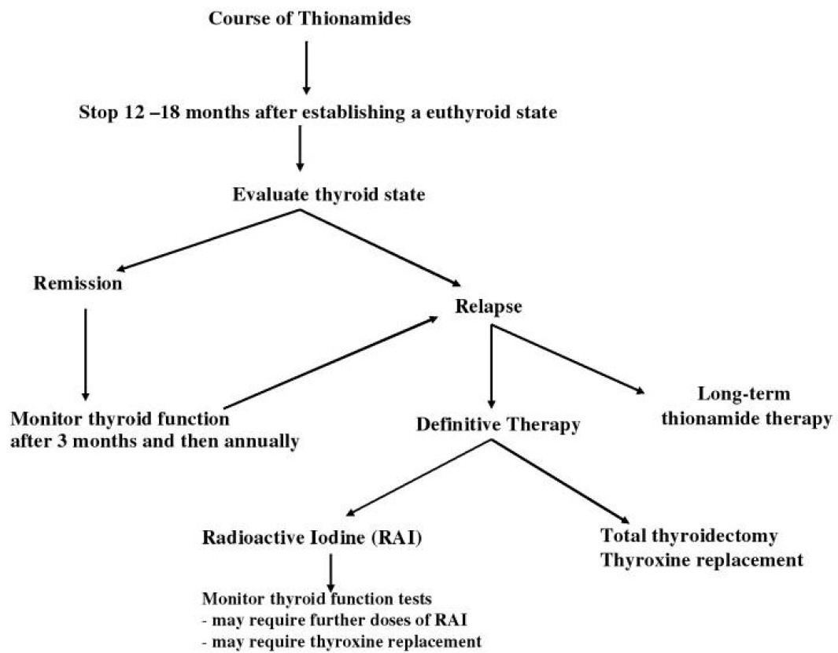
Treatment Algorithm For Grave’s Disease

Slide 22
Treatment Algorithm For Grave’s Disease

Slide 23
Treatment Algorithm For Grave’s Disease

Slide 24
Treatment Algorithm For Grave’s Disease

Slide 25
Case 3
36 yrs/F
Toxic symptoms: 6 months
Weight loss ~ 10 kg
Large diffuse goiter
 | Pt’s | Normal range
TSH | < 0.001 | 0.4 – 4
Total T4 | > 30 | 4.5 – 12.5
Total T3 | > 800 | 60 – 200

Slide 26
Treatment Algorithm For Grave’s Disease

Slide 27
Hyperthyroidism in Pregnancy : Addressing the Challenges
Copyright © 2011 Abbott India Limited. All rights reserved

Slide 28
Effect of Hyperthyroidism on Pregnancy
Untreated severe hyperthyroidism causes a number of menstrual disturbances
Pregnant hyperthyroid women are at a risk of:
Miscarriage
Abortions
Still births
Intrauterine growth restriction (IUGR)
Premature labor
Neonatal hyperthyroidism
Perinatal mortality
Pregnant women with mild hyperthyroidism on treatment have good outcomes
Uncontrolled disease may result in thyroid crisis (storm) or heart failure during delivery
Zainuddin Z, Shaker AAH. The Family Physician. 2005;13(3).
Notes:
In cases of severe hyperthyroidism before pregnancy, if the patient is not adequately treated, she may be at the risk of infertility due to nonovulation and irregular menstrual cycles. If the patient becomes pregnant and is left untreated, miscarriage, abortions, still births, intrauterine growth restriction (IUGR), premature labor, neonatal hyperthyroidism, and perinatal mortality are some of the complications that may arise.¹(/p3/col1/para1)
Adequately treated pregnant women with mild hyperthyroidism have good outcomes and the fetus is generally not affected by the disease.
As mentioned earlier, severe untreated situations may result in complications, sometimes resulting in a thyroid crisis or heart failure especially during delivery.¹(/p3/col1/para1)
Reference
Zainuddin Z, Shaker AAH. Hyperthyroidism in Pregnancy. The Family Physician. 2005;13(3):2-4.

Slide 29
Hyperthyroidism
Increased secretion of thyroid hormones
Causes of Hyperthyroidism
Toxic diffuse goiter (Graves’ disease)
Toxic adenoma
Toxic multinodular goiter (Plummer’s disease)
Painful subacute thyroiditis
Silent thyroiditis, including lymphocytic and postpartum thyroiditis
Iodine-induced hyperthyroidism
Excessive pituitary TSH or trophoblastic disease
Excessive ingestion of thyroid hormones¹
HCG-associated transient thyrotoxicosis²
1. Baskin HJ, et al. Endocr Pract. 2002;8(6):457-469.
2. Rodien P. Hum Reprod Update. 2004;10(2):95-105.
Notes:
To begin with, let’s discuss the causes and salient features of hyperthyroidism.
Hyperthyroidism occurs due to an increased secretion (overproduction) of thyroid hormones. It is caused due to several reasons, including toxic diffuse goiter, also known as Graves’ disease; toxic adenoma; toxic multinodular goiter, also known as Plummer’s disease; painful subacute thyroiditis; silent thyroiditis, including lymphocytic and postpartum thyroiditis; iodine-induced hyperthyroidism; excessive pituitary thyroid stimulating hormone (TSH) or trophoblastic disease; and excessive ingestion of thyroid hormones.¹(/p458/col2/para5) (/p459/col1/para1)
Both invitro and invivo studies have proved the thyrotrophic activity of HCG. (/p95/col1/para3;/col2/para1) It is reported that peak levels of HCG are invariably related to suppressed TSH levels. ²(/p96/col1/para1) Increase in thyroid hormone under the influence of hCG is associated with decreased TSH levels. This causes transient thyrotoxicosis. ²(/p96/col2/para3)
References
1. Baskin HJ, Cobin RH, Duick DS, et al. American Association of Clinical Endocrinologists medical guidelines for clinical practice for the evaluation and treatment of hyperthyroidism and hypothyroidism. Endocr Pract. 2002;8(6):457-469.
2. Rodien P, Jordan N, Lefevre A, et al. Abnormal stimulation of the thyrotrophin receptor during gestation. Hum Reprod Update. 2004;10(2):95-105.

Slide 30
Case 4
24/F
2 MA
Asymptomatic
No goiter
 | Pt’s | Normal range
TSH | 0.01 | 0.4 – 4
Free T4 | 1.5 | 0.8 – 1.8

Slide 31
Management ?
Rx: Antithyroid drugs
USG Thyroid
Tc99 Thyroid scan
TSH receptor Antibody

Slide 32
Management ?
Rx: Antithyroid drugs
USG Thyroid
Tc99 Thyroid scan
TSH receptor Antibody

Slide 33
Management ?
Rx: Antithyroid drugs
USG Thyroid
Tc99 Thyroid scan
TSH receptor Antibody: Negative

Slide 34
Management ?
Wait & watch
Reason:
Diagnosis: Gestational thyrotoxicosis due to hCG (not Grave’s disease)
Common in the 1st trimester
Recover by 12-16 weeks of gestation

Slide 35
Follow up: 20 weeks
 | Pt’s | Normal range
TSH | 0.01 | 0.4 – 4
Free T4 | 1.5 | 0.8 – 1.8

Slide 36
Why ?
USG: Twin pregnancy
Twin pregnancy: high hCG
Wait & watch: bcz Free T4 is normal

Slide 37
Case 5
24/F
2 MA
Toxic Symptoms
Mild goiter
TSH R Ab: Positive
 | Pt’s | Normal range
TSH | 0.01 | 0.4 – 4
Free T4 | 2.6 | 0.8 – 1.8

Slide 38
Management ?
Rx:
1st Trimester – PTU
2nd /3rd Trimester – CMZ/MMZ
Monitor Free T4, TSH every 4 weekly
Target
TSH: Normal
Free T4: High Normal (upto 20 % higher than ULN)

Slide 39
Effect of Pregnancy on Graves’ Disease
Aggravated symptoms of Graves’ disease during the 1st trimester due to increased hCG production
Thyrotoxicosis improves in the 2nd & 3rd trimester of pregnancy
Postpartum, symptoms increase due to a sudden rise in the level of TSH receptor stimulating antibodies
Reduction of TSH receptor stimulating antibody levels during pregnancy improves symptoms of Graves’ disease
1st trimester
2nd trimester
3rd trimester
Post-partum
Notes:
During pregnancy, the natural immunosuppression that occurs in the mother improves thyrotoxicosis. This is more prevalent in the second and third trimesters. The antibody levels that are generally high in Graves’ disease, fall to a level that considerably improves the symptoms of Graves’ disease. However, these changes are only seen in the second and third trimester. In the first trimester and postpartum, there may be sudden spurts of symptoms of Graves’ disease. This occurs because in the first trimester, there is an increase in hCG production, which may lead to a sudden outburst of symptoms, and in postpartum due to a rise in the levels of TSH receptor stimulating antibodies, the symptoms of Graves’ disease appear again. (/p2/col2/para3)
Reference
Zainuddin Z, Shaker AAH. Hyperthyroidism in pregnancy. The Family Physician. 2005;13(3):2-4.

Slide 40
Postpartum Thyroiditis

Slide 41
Postpartum thyroiditis
In the first postpartum year
Manifestations:
Transient hyperthyroidism
Transient hypothyroidism
Transient hyperthyroidism followed by permanent hypothyroidism
Stagnaro-Green A. Clinical review 152: postpartum thyroiditis. J Clin Endocrinol Metab. 2002;87(9):4042-4047.
Notes:
PPT is an inflammatory thyroid disorder that usually occurs during the first postpartum year, and it is manifested as transient hyperthyroidism, transient hypothyroidism or as hyperthyroidism followed by transient hypothyroidism.
This condition is caused due to a reversal of the partial immunosuppression caused by pregnancy, resulting in an intensification or worsening of the underlying autoimmune thyroiditis.
References:
Stagnaro-Green A. Clinical review 152: postpartum thyroiditis. J Clin Endocrinol Metab. 2002;87(9):4042-4047.

Slide 42
PPT: 2017 Guidelines
Thyrotoxic phase:
Beta-blockers for symptoms
ATDs are not recommended
Monitor serum TSH approximately 4–6 weeks
Hypothyroid phase: Treat if
Symptomatic
Lactating
Planning a pregnancy
Alexander EK, Pearce EN, Brent GA, et al. 2017 Guidelines of the American Thyroid Association for the Diagnosis and Management of Thyroid Disease During Pregnancy and the Postpartum. Thyroid. 2017 Mar;27(3):315-389.

Slide 43
Case 3
30 yrs/F
5 months postpartum
Asymptomatic
No Thyroid swelling
 | Pt’s | Normal range
TSH | 0.001 | 0.4 – 4
Free T4 | 1.4 | 0.8 – 1.8

Slide 44
Management ?
ATDs
Tc99 Thyroid scan
TSH R Ab
USG

Slide 45
Management ?
ATDs
Tc99 Thyroid scan
TSH R Ab
USG

Slide 46
Management ?
ATDs
Tc99 Thyroid scan
TSH R Ab: Negative
USG

Slide 47
Management ?
Wait & Watch
 | 1st visit | > 1 month
TSH | 0.001 | 0.8
Free T4 | 1.4 | 1.2

Slide 48
Management ?
Wait & Watch
 | 1st visit | > 1 month | > 2 months
TSH | 0.001 | 0.8 | 26
Free T4 | 1.4 | 1.2 | 1.2

Slide 49
Management ?
Wait & Watch
 | 1st visit | > 1 month | > 2 months | > 4 months
TSH | 0.001 | 0.8 | 26 | 3
Free T4 | 1.4 | 1.2 | 1.2 | 1.3

Slide 50
> 2 years
Weight gain ~ 4 kg
Generalised weakness
 | Pt’s | Normal range
TSH | 50 | 0.4 – 4
Free T4 | 1.1 | 0.8 – 1.8

Slide 51
Thyrotoxic crisis

Slide 52
Introduction
Medical emergency
High mortality rate (up to 30 %)
Rare nowadays (due to early diagnosis)

Slide 53
Etiology
Long standing untreated hyperthyroidism
Precipitating factors:
Trauma
Infection
Surgery (thyroid/non thyroid)
Acute iodine load

Slide 54
T3, T4, TSH
Required to diagnose hyperthyroidism
Doesn’t differentiate b/w compensated hyperthyroidism & Thyrotoxic crisis

Slide 55
Clinical features
Tachycardia
Nausea/vomiting/abdominal pain
Hepatic failure with jaundice
Hypotension/CHF/Arrythmia
Hyperpyrexia (Temp. upto 104 to 106)
Agitation/psychosis/delirium/stupor/coma

Slide 56
Management
Beta blockers
Methimazole/PTU
Iodine solution
Glucocortisoids
Bile acid sequestrants
Supportive measures:
ABC
Rx of coexistent illness (e.g. infection)

Slide 57
Beta blockers
Propranolol:
60-80 mg every 4-6 hourly
Adjusted by Heart rate/BP
To improve symptoms/signs related to sympathetic overactivity

Slide 58
Thionamides
Carbimazole:
30 mg every 4-6 hourly
Methimazole:
20 mg every 4-6 hourly
PTU
200 mg every 4 hourly
PTU > Methimazole:
Preferred, because it inhibits conversion of T4 to T3 as well

Slide 59
Glucocorticoid
Hydrocortisone
100 mg i.v. 8 hourly
Interferes with T4 to T3 conversion
Possibly, halts autoimmune process in Grave’s disease.

Slide 60
Iodine solution
SSKI:
5 drops every 6 hourly
Lugol’s iodine:
10 drops every 8 hourly
Start 1 hour after the thionamide dose

Slide 61
How to make SSKI ?
144 gms potasium iodide
100 ml water

Slide 62
Iodinated contrast agents
Iopanoic acid
0.5-1 gm/day
Interferes with T4 to T3 conversion
Inhibits release of thyroid hormones from thyroid gland

Slide 63
Bile Acid Sequestrants
Cholestryramine
4 gm every 6 hourly
Interferes with enterohepatic circulation & recycling of thyroid hormones

Slide 64
Conclusion
“Low TSH” means “Hyperthyroidism” = Not always
Need to identify the cause of hyperthyroidism
Individualize the treatment as per the etiology
Compared to Hypothyroidism, hyperthyroidism needs aggressive management

