Slide 1
Diabetes & Your Health
Dr Hiren Patt
Endocrinologist & Diabetologist

Slide 2
What is DM ?

Slide 3
What is DM ?
 | Normal | Pre DM | DM
FBS | < 100 | 100 – 125 | ≥ 126

Slide 4
What is DM ?
 | Normal | Pre DM | DM
FBS | < 100 | 100 – 125 | ≥ 126
PPBS | < 140 | 140 – 199 | ≥ 200

Slide 5
What is DM ?
 | Normal | Pre DM | DM
FBS | < 100 | 100 – 125 | ≥ 126
PPBS | < 140 | 140 – 199 | ≥ 200
HbA1c | < 5.7 % | 5.7 – 6.4 % | ≥ 6.5 %

Slide 6
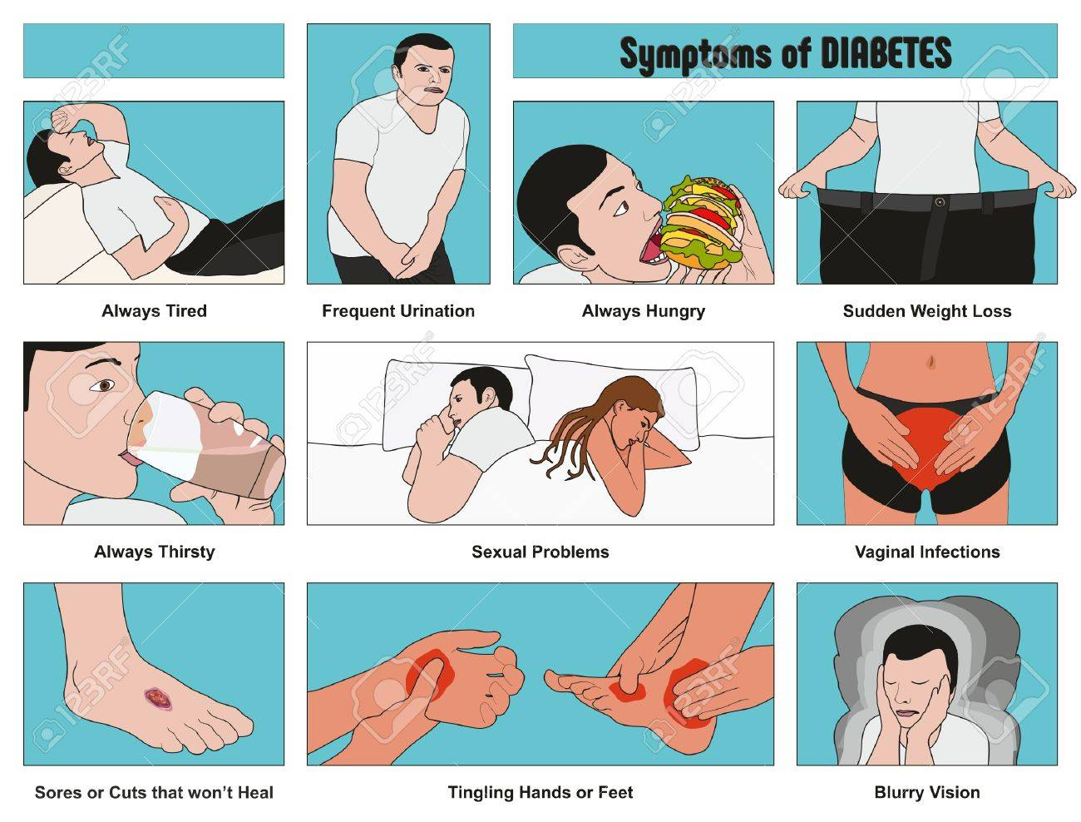
Symptoms of Diabetes

Slide 8
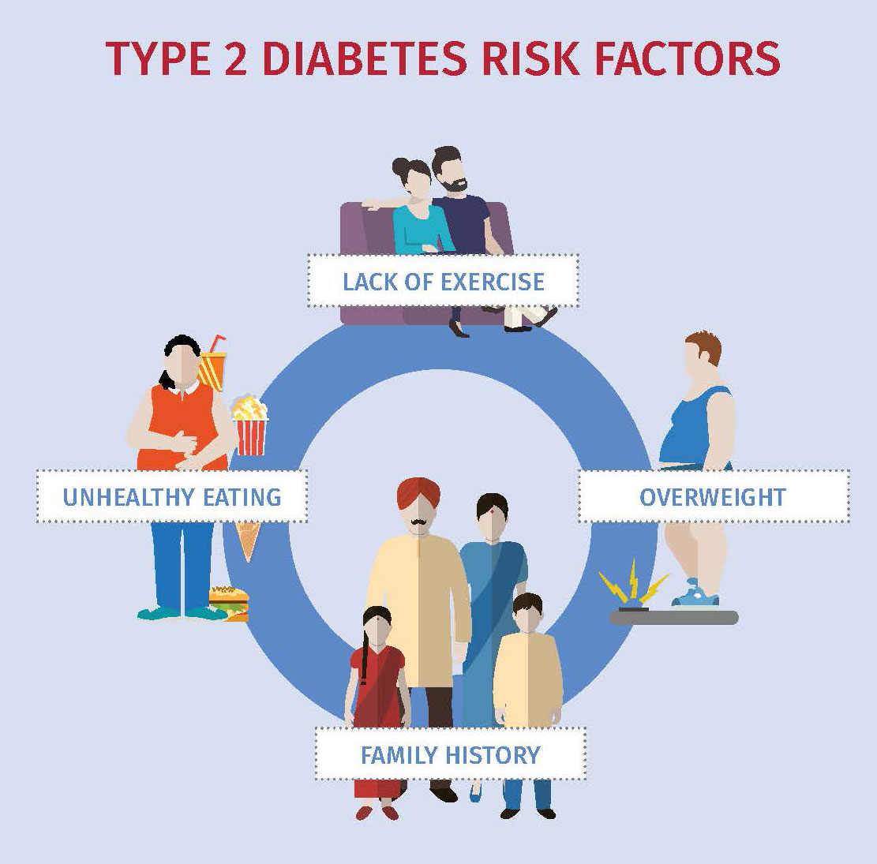
Causes of Diabetes (Type 2)

Slide 9
Causes of Diabetes (Type 2)

Slide 10
Ideal Weight
Height | Ideal Weight
5’1” | 53
5’3” | 56
5’5” | 59
5’7” | 63

Slide 11
Weight = Savings
Savings = Earning – expense
If you want to lose weight
Reduce your earning (diet)
Increase your expense (exercise)

Slide 12
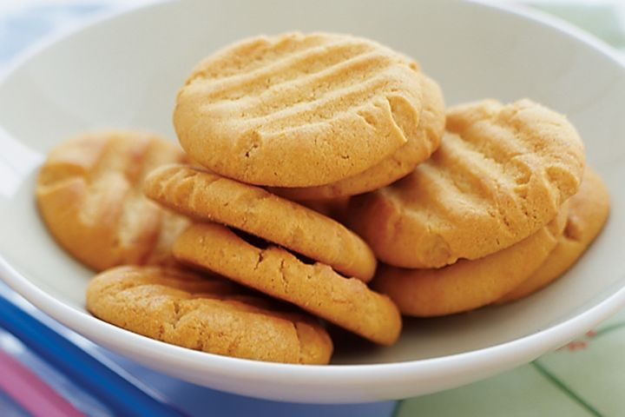
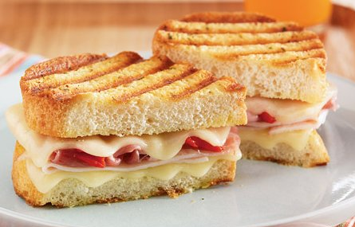
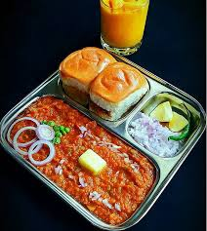
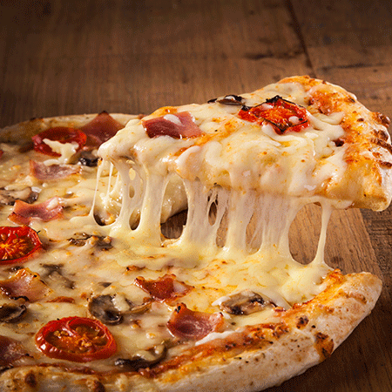
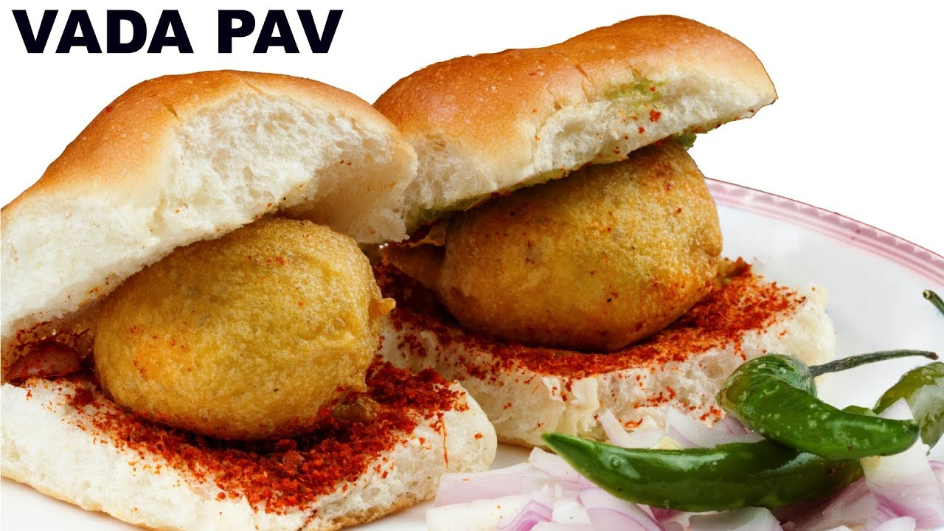
Unhealthy Food Items

Slide 13
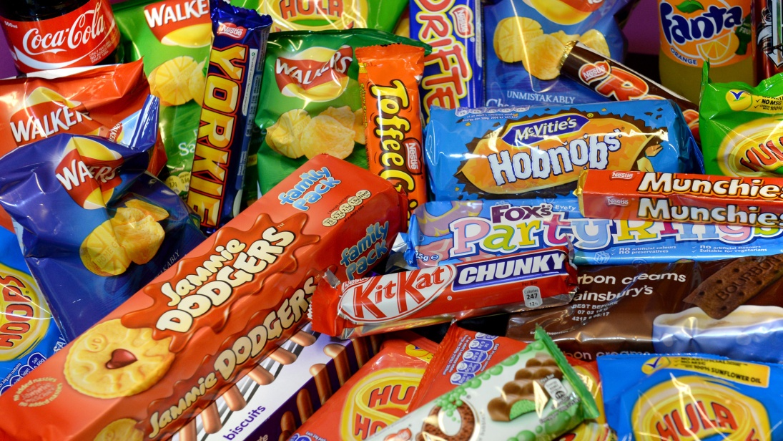
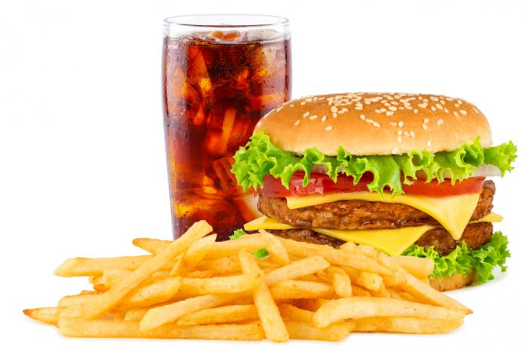
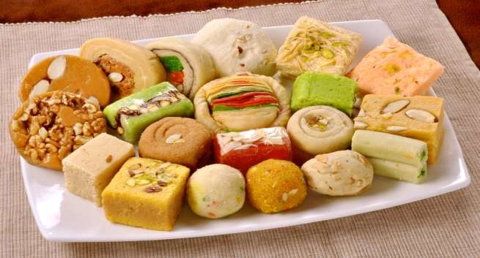
Unhealthy Food Items

Slide 14
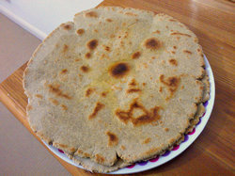
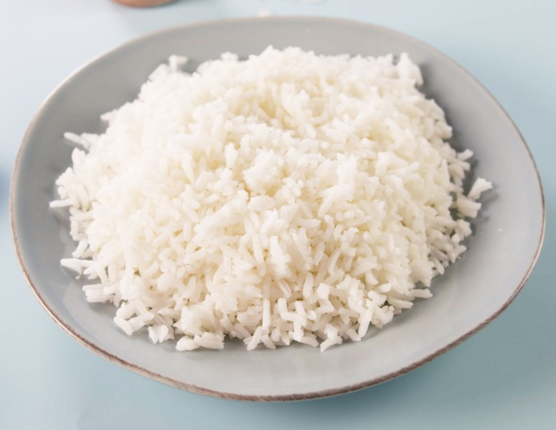
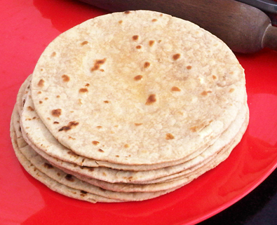
Unhealthy Food Items

Slide 15
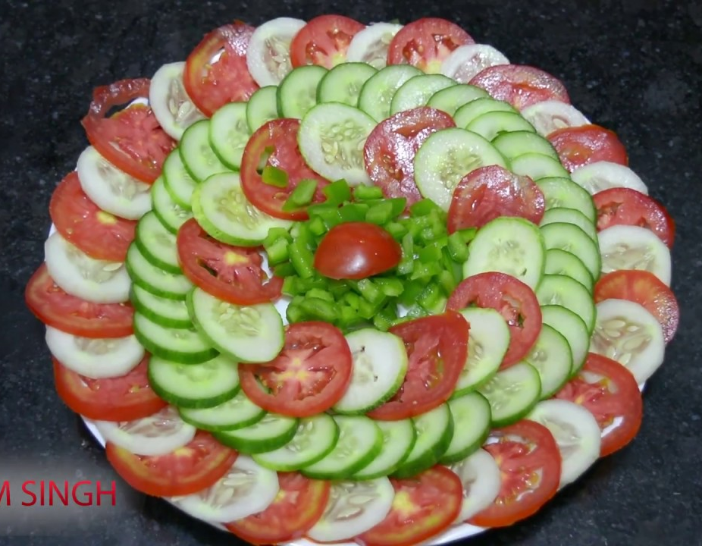
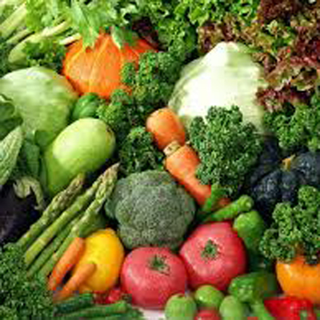
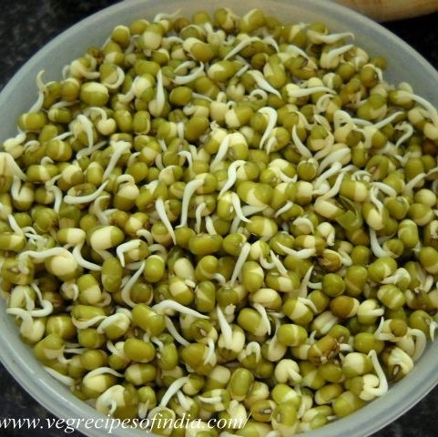
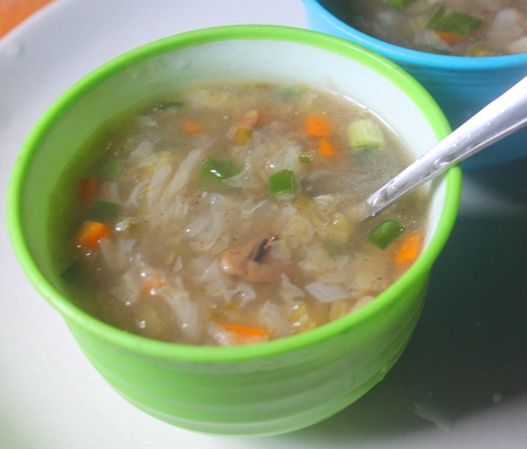
Healthy Food Items

Slide 16
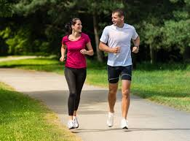
Burning Calories – Equally Important

Slide 17
Why do we need to control DM ?

Slide 18
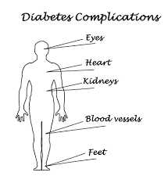
Complications of Diabetes

Slide 19
Monitoring of DM
FBS/PPBS – monthly
HbA1c – 3 monthly
SMBG – (when on insulin)

Slide 20
How do you know your diabetes is controlled ?
FBS | < 130
PPBS | < 180
HbA1c | < 7 %

Slide 21
