Slide 1
Acarbose in DM
Dr Hiren Patt
D.M. (Endocrinology)
(K.E.M., Mumbai)

Slide 2
M.B.B.S. – B.J. Medical College, A’bad
M.D. (Medicine) – B.J. medical College, A’bad
D.M. (Endocrinology) – K.E.M., Mumbai
Consultant Endocrinologist
Narayana hospital, A’bad
Clinic – Satellite, A’bad

Slide 3
Acarbose in DM
Dr Hiren Patt
D.M. (Endocrinology)
(K.E.M., Mumbai)

Slide 4
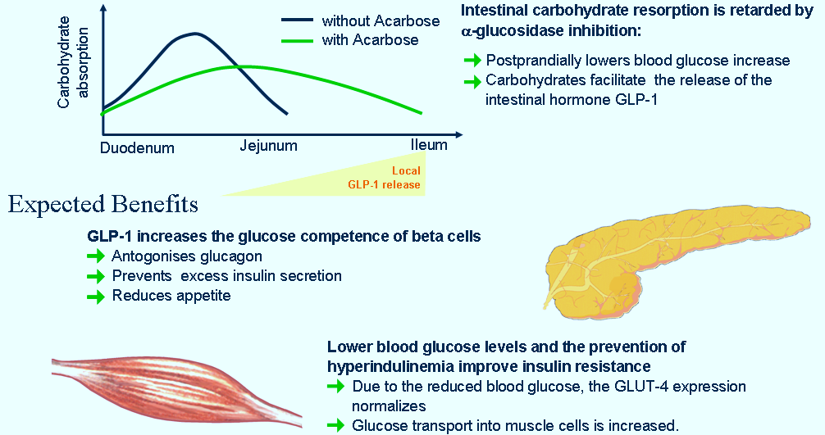
AGI’s Unique Mode of Action
Primarily takes care of PPG for Comprehensive Control
Alpha-glucosidase inhibition leads to
Delay in Intestinal carbohydrate absorption
Lower postmeal hyperglycemia
Prevention of hyperinsulinemia
Improves insulin resistance
Carbohydrates in lower intestine facilitate GLP-1 release
L.IN.MA.GM.01.2016.0963
Clin Drug Invest 2002; 22 (3): 141-156

Slide 5
Acarbose & Glycemic Variability

Slide 6
Place of Acarbose in modern day management of Diabetes
Glucose variability is it really important for clinical management?

Slide 7
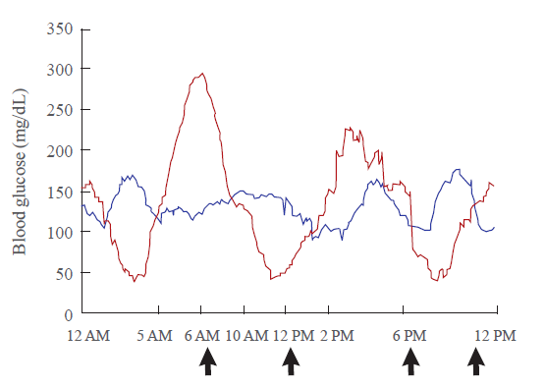
Important fluctuations can be missed simply because they occur between two measurements
Twenty-four-hour glycemic curves of two patients with diabetes
The two patients exhibit different patterns of glycemic variation
However, standard deviations calculated across all four points, before each meal and at bedtime (arrows), do not reflect this because the glucose measures are similar between the two patients at those points
Hye Seung Jung, Endocrinol Metab 2015;30:167-174

Slide 8
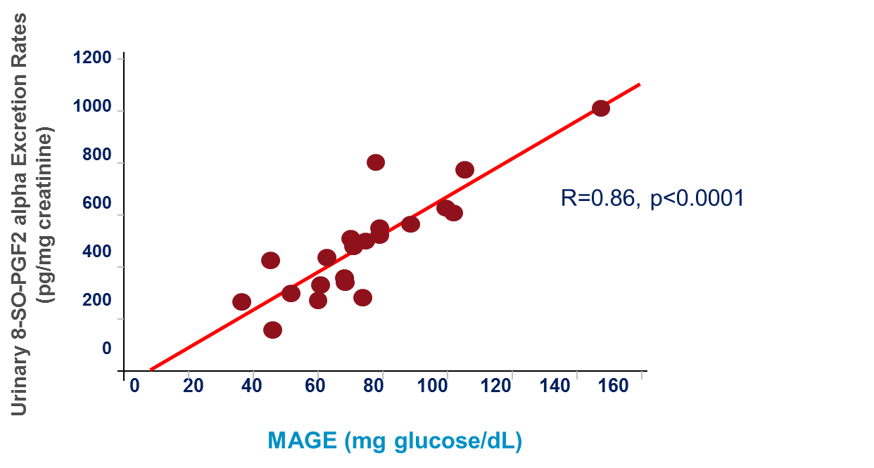
Correlation Between Urinary 8-iso-PGF2 alpha and MAGE in T2DM
Post-meal spikes correlates strongly with oxidative stress
MAGE, Mean amplitude of glycemic excursion
Monnier L, et al. JAMA. 2006;295:1681-1687.
Notes:
Monnier et al showed that in patients with T2DM, glucose fluctuations during postprandial periods and generally during glucose swings, correlated strongly with oxidative stress.
Oxidative stress was determined by measuring urinary excretion rates of 8-iso prostaglandin (PG)F2alpha.
Acute glucose fluctuations increased oxidative stress to a greater extent than chronic hyperglycemia.

Slide 9
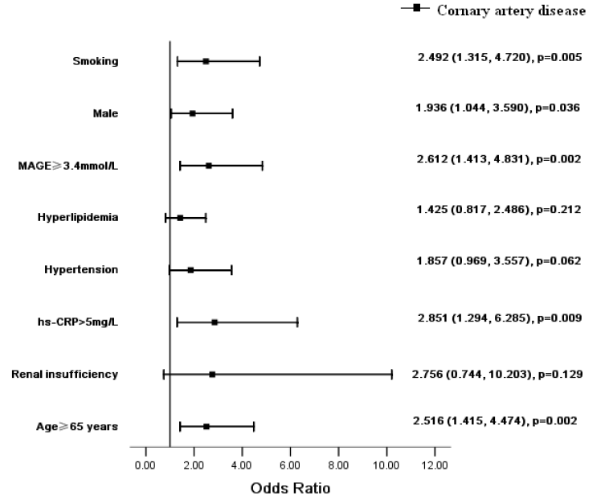
Multivariate analysis for independent determinants of coronary artery disease
Glycemic excursion is a independent risk factors for CAD¹
Repeated PPHG episodes are now considered to have greater pathophysiological effects on CV system than persistent hyperglycaemia²
Su et al. Cardiovascular Diabetology 2011, 10:19
Wayne Sheu et al. Diab Res & Cli Prac 2011

Slide 10
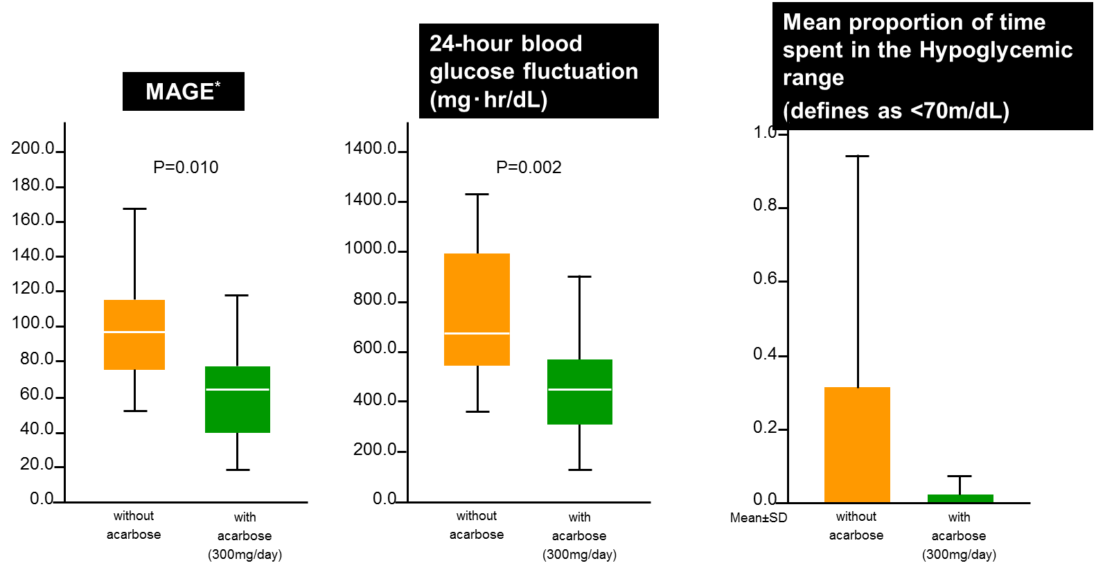
Effects of Acarbose on Glucose Fluctuations in T2D patients receiving Insulin therapy
N=10, Therapy for diabetes consisted of only diet therapy in two, long-acting insulin once a day in three, biphasic insulin analog two or three times a day in two, and intensive insulin therapy in three patients.
10
Y Mori :Diabetes Technology & Therareutics, 13, 2011
*MAGE: mean amplitutde of glycemia excursions
Notes:
Abstract
Background: The objective of this study was to evaluate the effects of the a-glucosidase inhibitor acarbose on
glucose fluctuations in patients with type 2 diabetes using continuous glucose monitoring (CGM).
Methods: CGM was performed for 4 days (72 h), and acarbose at 300mg/day was administered on two of these
days but not on the other two days. The effects on blood glucose fluctuations were evaluated.
Results: We recruited a total of 10 patients (five men and five women) with a meanSD age of 63.112.1 years,
body mass index of 22.65.4 kg/m2, and glycohemoglobin of 9.91.9%. During treatment with acarbose,
significant decreases in median (range) SD of 24-h mean blood glucose (22.48 [6.39–47.22] mg/dL vs. 32.78
[18.83–58.93] mg/dL, P¼0.004), 24-h blood glucose fluctuations (453.27 [128.51–903.94] mgh/dL vs. 677.05
[358.03–1,234.57] mgh/dL, P¼0.002), and mean amplitude of glycemic excursions (65.00 [18.17–117.50] vs. 97.09
[53.00–166.67], P¼0.010) occurred compared with no treatment.
Conclusions: Acarbose reduced excessive blood glucose fluctuations.

Slide 11
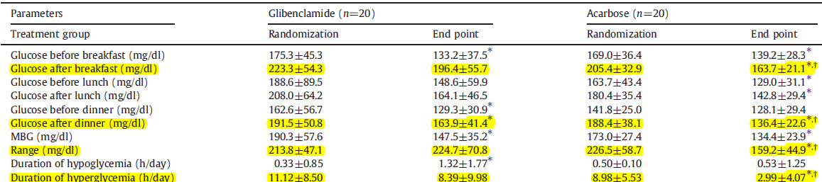
Acarbose reduces GV compared with sulfonylurea in Taiwanese T2D patients inadequately controlled with metformin
MBG, mean glucose of sensor; Range, sensor maximal glucose level minus minimal glucose level; hypoglycemia is defined as sensor glucose less than 70 mg/dL; hyperglycemia is defined as sensor glucose levels greater than 180 mg/dL
At the end of 16 weeks, the acarbose add-on group had a reduction in glucose range
Duration of hyperglycemia decreased after administration of acarbose, while increased after glibenclamide
*p<0.05 compared with randomization in each group. † P<0.05 compared with end point in glibenclamide add-on group
11
J Diabetes Complications 2011, 25(5):332–338
Notes:
Aims: Although sulfonylurea added to metformin is the !rst oral drug combination regimen for patients with
type 2 diabetes recommended by the American Diabetes Association/European Association for the Study of
Diabetes consensus statement, it does not allow for individualizing and optimizing therapy with respect to
sustaining glycemic control and the reduction of glucose variability. We therefore sought to investigate
acarbose as an alternative to glibenclamide in combination with metformin and compare the effects on
metabolic control and glucose variability.
Methods: Type 2 diabetic patients 30–70 years of age with glycosylated hemoglobin 7.0%–11.0% while treated
with one or two oral antidiabetic drugs were successively enrolled. After 8 weeks of run-in with metformin
500 mg thrice daily, either acarbose 50 mg or glibenclamide 2.5 mg three times daily was randomly added on
and force titrated to acarbose 100 mg or glibenclamide 5.0 mg three times daily for the subsequent 16 weeks.
Demographic data, biochemical data and continuous glucose monitoring system data were recorded upon
randomization and at the end of the study. Various parameters that measure glucose variability were derived
from the continuous glucose monitoring system data.
Results: Of the 51 type 2 diabetes patients enrolled, data from 40 subjects, 20 in each group, were analyzed
after excluding those unquali!ed information. Both drug combinations improved glycemic control. Glucose
variability, expressed as mean amplitude of glycemic excursion or continuous overall net glycemic action and
mean of daily differences, decreased signi!cantly (all Pb.05) after the addition of acarbose but not
glibenclamide. The acarbose–metformin combination has the additional bene!ts of weight reduction and
shorter durations of hyperglycemia compared with metformin monotherapy.
Conclusions: This study suggests that both intraday and interday glucose variability are more effectively
reduced by the acarbose–metformin combination than by the glibenclamide–metformin combination, while
both combinations reduce the overall glucose level equally.

Slide 12
Acarbose as add-on to DPP4i: 24 hour CGM profiles with and without acarbose
After adding acarbose, glucose levels were significantly improved after breakfast# and dinner#
300
Alogliptin
Alogliptin + acarbose
250
200
v
v
#
#
Plasma glucose (mg/dl)
150
100
50
0
0
3
6
9
12
15
18
21
24
Time (hours)
#p<0.05 with acarbose vs. without (paired t-test or Wilcoxon signed rank test).
Kusunoki Y, et al. Endocr J 2013;60:431-9
Notes:
Abstract. Acarbose was administered at 300 mg/day to patients with type 2 diabetes mellitus (T2DM) who had been
taking 25 mg/day of alogliptin, and levels of blood glucose were analyzed by continuous glucose monitoring (CGM) for 3
days. The mean blood glucose level with acarbose (136.4 ± 30.7 mg/dL) did not differ significantly from that without
acarbose (141.7 ± 28.3 mg/dL). However, in the condition of the combination therapy, there were significant decreases in
the standard deviation of the mean blood glucose levels for the 24-hour period (27.6 ± 9.1 vs. 16.2 ± 6.9 mg/dL, p<0.001)
and mean amplitude of glycemic excursions (MAGE) (65.8 ± 26.1 vs. 38.8 ± 19.2 mg/dL, p=0.010). In addition, a meal
tolerance test was conducted to monitor changes in insulin secretion and active GLP-1 and total GIP values. Ten subjects
(5 males, 5 females) of 54.9 ± 6.9 years with BMI 25.9 ± 5.2 kg/m2 and HbAlc 9.2 ± 1.2% were enrolled. In the meal
tolerance test, active GLP-1 values before and after acarbose administration were 17.0 ± 5.8 and 24.1 ± 9.3 pmol･hr/mL
(p=0.054), respectively, showing an increasing tendency, and total GIPAUC0-180 values were 685.9 ± 209.7 and 404.4 ±
173.7 pmol･hr/mL, respectively, showing a significant decrease (p=0.010). The results indicate that the combined
administration of both inhibitors is effective not only in decreasing blood glucose fluctuations and preventing postprandial
insulin secretion. The beneficial effects may also protect the endocrine pancreas and inhibit body weight gain.
In CGM, blood glucose fluctuations were analyzed before the administration of acarbose on the first day, and after administration of 100 mg/day of acarbose on the second and third day.

Slide 13
Effects of Acarbose on Glucose Fluctuations after add on to Insulin
Glycemic fluctuation is significantly reduced after addition of acarbose to insulin therapy
Y Mori :Modern Physician 28: 1115-1119, 2008
Notes:
13

Slide 14
Key Messages
Glycemic variability is mainly because of PPBS excursion
Glycemic excursions are linked with CV risks in T2DM
3. Favorable effect of Acarbose on Glucose variability aimed at an efficacy in the control of the metabolic alterations of diabetes
14

Slide 15
Acarbose & Gut Microbiota

Slide 16
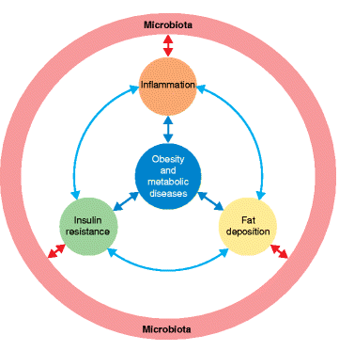
Impact of the gut microbiota on inflammation, obesity, and metabolic disease
The dysbiotic gut microbiota can contribute to
host insulin resistance,
low grade inflammation, and
fat deposition through a range of molecular interactions with the host
That indirectly participate in the onset of obesity and metabolic diseases
Boulangé et al. Genome Medicine (2016) 8:42

Slide 17
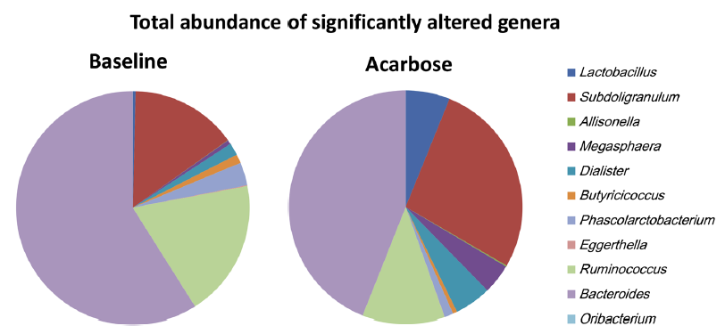
Average abundance of genera significantly altered by acarbose
Linong Ji, et al. Diabetes Ther. 2016
Study Results
Megasphaera could potentially transform carbohydrates into SCFAs, including butyrate, formate, acetate, valerate, and caproate, which is beneficial for Lactobacillus growth.
Wilcoxon rank sum tests were conducted to compare the normalized microbiota abundance before and after acarbose treatment
Notes:
Megasphaera could potentially transform carbohydrates into SCFAs, including butyrate, formate, acetate, valerate, and caproate, which is beneficial for Lactobacillus growth.
Dialister, which was in higher abundance following acarbose, was negatively correlated with HbA1c. Thus, some species of Dialister may play a role in the regulation of glucose metabolism

Slide 18
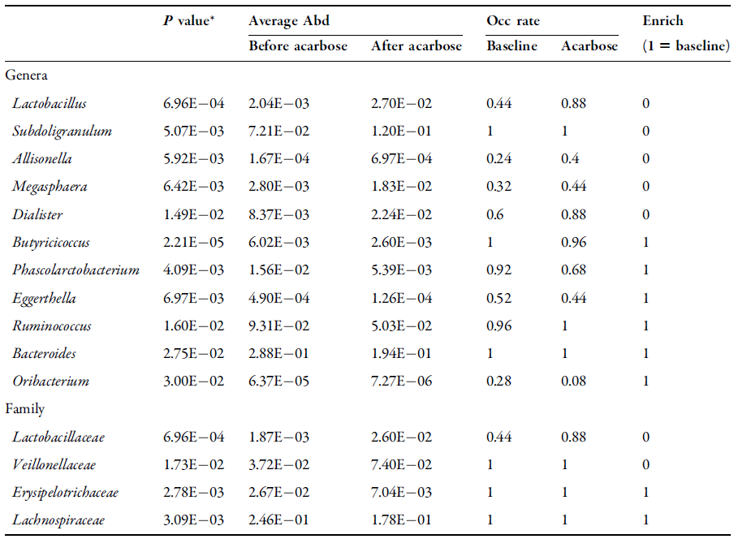
Abundance of genera significantly changed by acarbose:
Antidiabetic and additional effects of acarbose may be mediated by its selective modulation of the microbiota
Study Results
Linong Ji, et al. Diabetes Ther. 2016
Beneficial effects of
Lactobacillus includes:
improving T2DM,
antidiabetic and anti-inflammatory effects, and
reducing body weight
Megasphaera could
potentially transform carbohydrates into SCFAs which is beneficial for
Lactobacillus growth.

Slide 19
Acarbose in Indians

Slide 20

Relevance of AGIs in Indian Diabetics

Slide 21
Stratifications as per percent energy from Carbohydrate consumption
STARCH Study
There is a trend towards increasing 2 hPPG with an increase in Carbohydrate consumption
Joshi SR, Shah Parag, et al. BMJ Open 2014;4:e005138. doi:10.1136/bmjopen-2014-005138
L.IN.MA.GM.01.2016.0963
Notes:
There was a trend towards increasing 2 hPPBG with an increase in CHO consumption (% energy) if we consider participants with per cent energy consumption ≥50% from CHO (n=16, consuming <50% of total energy from CHO, hence not considered
However, the current study was not powered to investigate the effect of CHO consumption and relationship with glycaemic control.

Slide 22
Acarbose – Durability

Slide 23
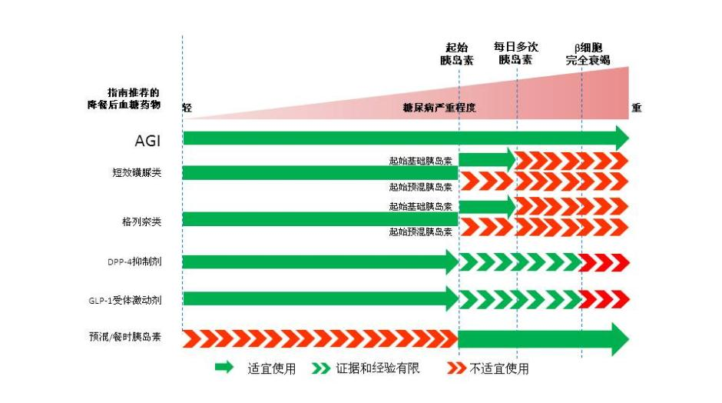
Recommendation for the choice of PPG lowering antidiabetic drugs in patients with type 2 diabetes
Multiple daily injections
Start insulin
Worsening β-cell function
Β细胞功能严重降低
Lowering PPG drugs
Mild
Severity of DM
Severe
Short-acting sulphonylureas
Start with basal insulin
Start with pre-mixed insulin
Start with basal insulin
Glinides
Start with pre-mixed insulin
DPP-4 inhibitors
GLP-1 agonist
Pe-mixed/Mealtime
insulin
Recommended
Limited evidence
Not recommended
Notes----Combination of sulphonylureas and glinides is forbidden .
Antidiabetics with different mechanisms can be prescribed at the same time.
1.International Diabetes Federation. 2011 Guideline for management of postmeal glucose in diabetes.
2.International Diabetes Federation Guideline Development Group. Guideline for management of postmeal glucose in diabetes. Diabetes Res Clin Pract, 2014, 103(2): 256-268.

Slide 24
Case Based Discussion

Slide 25
Case 1
54 years/female
DM: 15 years
Generalised weakness
Burning micturition (UTI)

Slide 26
Investigations
FBS – 220
PPBS – 360
HbA1c – 10 %
Creat – 0.9
Current Rx:
Metformin 1 gm/day
Glimiperide 4 mg/day
Teneligliptin 20 mg/day

Slide 27
What Next ?
Metformin 2 gms/day
Glimeperide 8 mg/day
SGLT2i
Pioglitazone
Insulin

Slide 28
What Next ?
Metformin 2 gms/day
Glimeperide 8 mg/day
SGLT2i
Pioglitazone
Insulin

Slide 29
What Next ?
Metformin 2 gms/day
Glimeperide 8 mg/day
SGLT2i
Pioglitazone
Insulin – Basal + Bolus or Basal + Acarbose

Slide 30
Basal + Acarbose
FBS
Basal insulin
PPBS
Acarbose
Dietary modification

Slide 31
Management
Acarbose 25 mg 1-1-1
Glargine 16 units daily

Slide 32
> 5 days
FBS – 95
PPBS – 148

Slide 33
Case 2
64 yrs/F
Uncontrolled DM
BBF | 134
ABF | 185
BL | 176
AL | 304
BD | 283
AD | 346

Slide 34
Current Rx
Metformin 2 gm/day
Glimiperide 4 mg/day
Glargine 28 units/day

Slide 35
What Next ?
DPP4i
SGLT2i
Prandial GLP1 agonist: Lixisenatide
Acarbose
Bolus Insulin: Regular/Lispro/Aspart/Glulisine

Slide 36
What Next ?
DPP4i
SGLT2i
Prandial GLP1 agonist: Lixisenatide
Acarbose
Bolus Insulin: Regular/Lispro/Aspart/Glulisine

Slide 37
Management
Acarbose 25 mg 1-1-1
 |  | PP Excursion
BBF | 112
ABF | 145 | 33
BL | 138
AL | 239 | 101
BD | 223
AD | 249 | 26

Slide 38
Basal Plus
Basal + 1 Bolus
Bolus:
Largest meal (highest PPBS)

Slide 39
Management
Regular Insulin 4 units before lunch
BBF | 108
ABF | 139
BL | 135
AL | 148
BD | 136
AD | 162

Slide 40
Conclusion

Slide 41
Advantages of Acarbose
Reduces Glycemic variability
Excellent PPBS control
Durability
Possible beneficial alteration of gut microbiota

Slide 42
Thanks

