Slide 1
Gaps in Insulin Initiation & Intensification
Dr Hiren Patt
D.M. (Endocrinology)

Slide 2
M.B.B.S. – B.J.M.C., A’bad
M.D.(Medicine) – B.J.M.C., A’bad
D.M. (Endocrinology) – KEM Hospital, Mumbai
Consultant Endocrinologist
K.D. Hospital, A’bad
Dr Hiren’s Endocrine clinic, Shivranjani, Satellite, A’bad

Slide 3
Gaps in Insulin Initiation & Intensification
Dr Hiren Patt
D.M. (Endocrinology)

Slide 4
Case
58 years/male
DM: 8 years
Weight loss (72 -> 70 kg)
Gen weakness, burning feet
FBS – 260
PPBS – 360
HbA1c – 10 %

Slide 5
Current Rx
Metformin 2 gm/day
Glimiperide 4 mg/day
Consults his family doctor
Sitagliptin 100 mg/day
Glimiperide 8 mg/day

Slide 6
> 1 months
FBS – 260 -> 240
PPBS – 360 -> 320
Doctor advises insulin Rx
Patient refuses
Comes back for follow up > 1 month
Uncontrolled DM

Slide 7
Consulted family doctor
Glargine 10 units/day
Adv.: follow up > 1 month
> 1 month
FBS – 240 -> 180
PPBS – 320 -> 280

Slide 8
Symptoms: Minor improvement
Consults another doctor
Premix 30/70
BBF 20 units
BD 16 units
Hypoglycemia BL

Slide 9
Stops Insulin
Uncontrolled DM for 2 months

Slide 10
Consults Endocrinologist
Endo: You have to be on Insulin
Patient: Dr, I am getting bad hypo on it
Endo: I will give you basal insulin, which is less likely to cause hypo
Patients: I have already taken it in the past, my sugars were not controlled on it

Slide 11
Problems
Delayed initiation
Slow up titration
Inappropriate Insulin therapy

Slide 12
Delayed Initiation

Slide 13
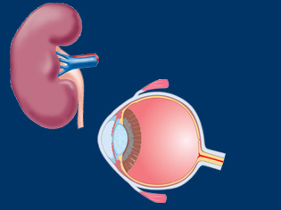
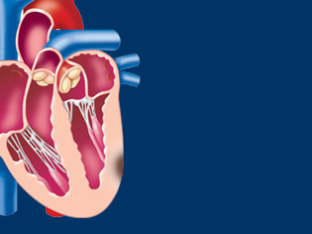
Drawbacks of the delayed initiation
Even short periods of hyperglycemia increase risk of complications
A proactive approach is required
to get patients to achieve their
glycemic goals sooner
Microvascular complications
80
Normal
HbA_{1c}
levels
60
Incidence per
1000 patient-years
40
Myocardial
infarction
20
0
0
5
6
7
8
9
10
11
Updated mean HbA_{1c} (%)
¹EDIC Group. JAMA 2003; 290:2159–2167. ²EDIC Group. JAMA 2002; 287:2563–2569.
³Nathan DM, et al. N Engl J Med 2003; 348:2294–2303.
Notes:
Stepwise management is a reactive strategy that can involve significant delays before stepping up to the next level of treatment.
Even short periods of hyperglycemia increase the risk of microvascular and macrovascular complications^{1–3} and a more proactive approach is therefore required to achieve glycemic goals sooner.
More intensive strategies, involving earlier introduction of combination therapy in parallel with a diet and exercise program, have the potential to improve glycemic control over the long term. This in turn should reduce the substantial burden associated with diabetes-related complications.
¹EDIC Group. JAMA 2003; 290:2159–2167.
²EDIC Group. JAMA 2002; 287:2563–2569.
³Nathan DM, et al. N Engl J Med 2003; 348:2294–2303.

Slide 14
Timely application of insulin therapy in type 2 diabetes has multiple benefits
Benefits
Restores β-cell function¹
Provides long-term near-normal glycemic control²
Reduces microvascular complications, providing long-term end-organ protection^{3,4}
May enhance patient QoL⁵
May reduce macrovascular events⁴
Challenges
Weight gain^{1,5}
Hypoglycaemia^{1,5}
Need for injection¹
1. Grunberger G. Diabetes Obes Metab 2013;15 Suppl 1:1-5; 2. ORIGIN Investigators. N Engl J Med 2012;367:319-28;
3. UKPDS 33. Lancet 1998;352:837-53; 4. Holman RR et al N Engl J Med 2008;359:1577-89;
5. Owens DR. Diabetes Technol Ther. 2013;15:776-85.

Slide 15
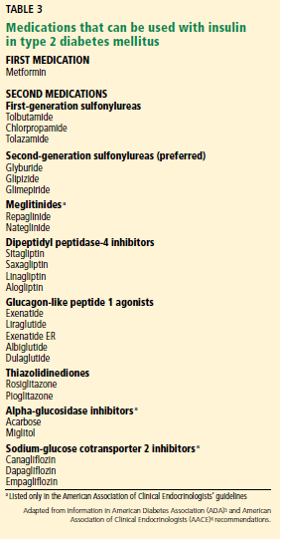
Initiating Insulin
Many insulin options are available, one of the most common being the addition of basal insulin to oral antidiabetic drugs.
1. Cleveland Journal of Medicine 2015 August

Slide 16
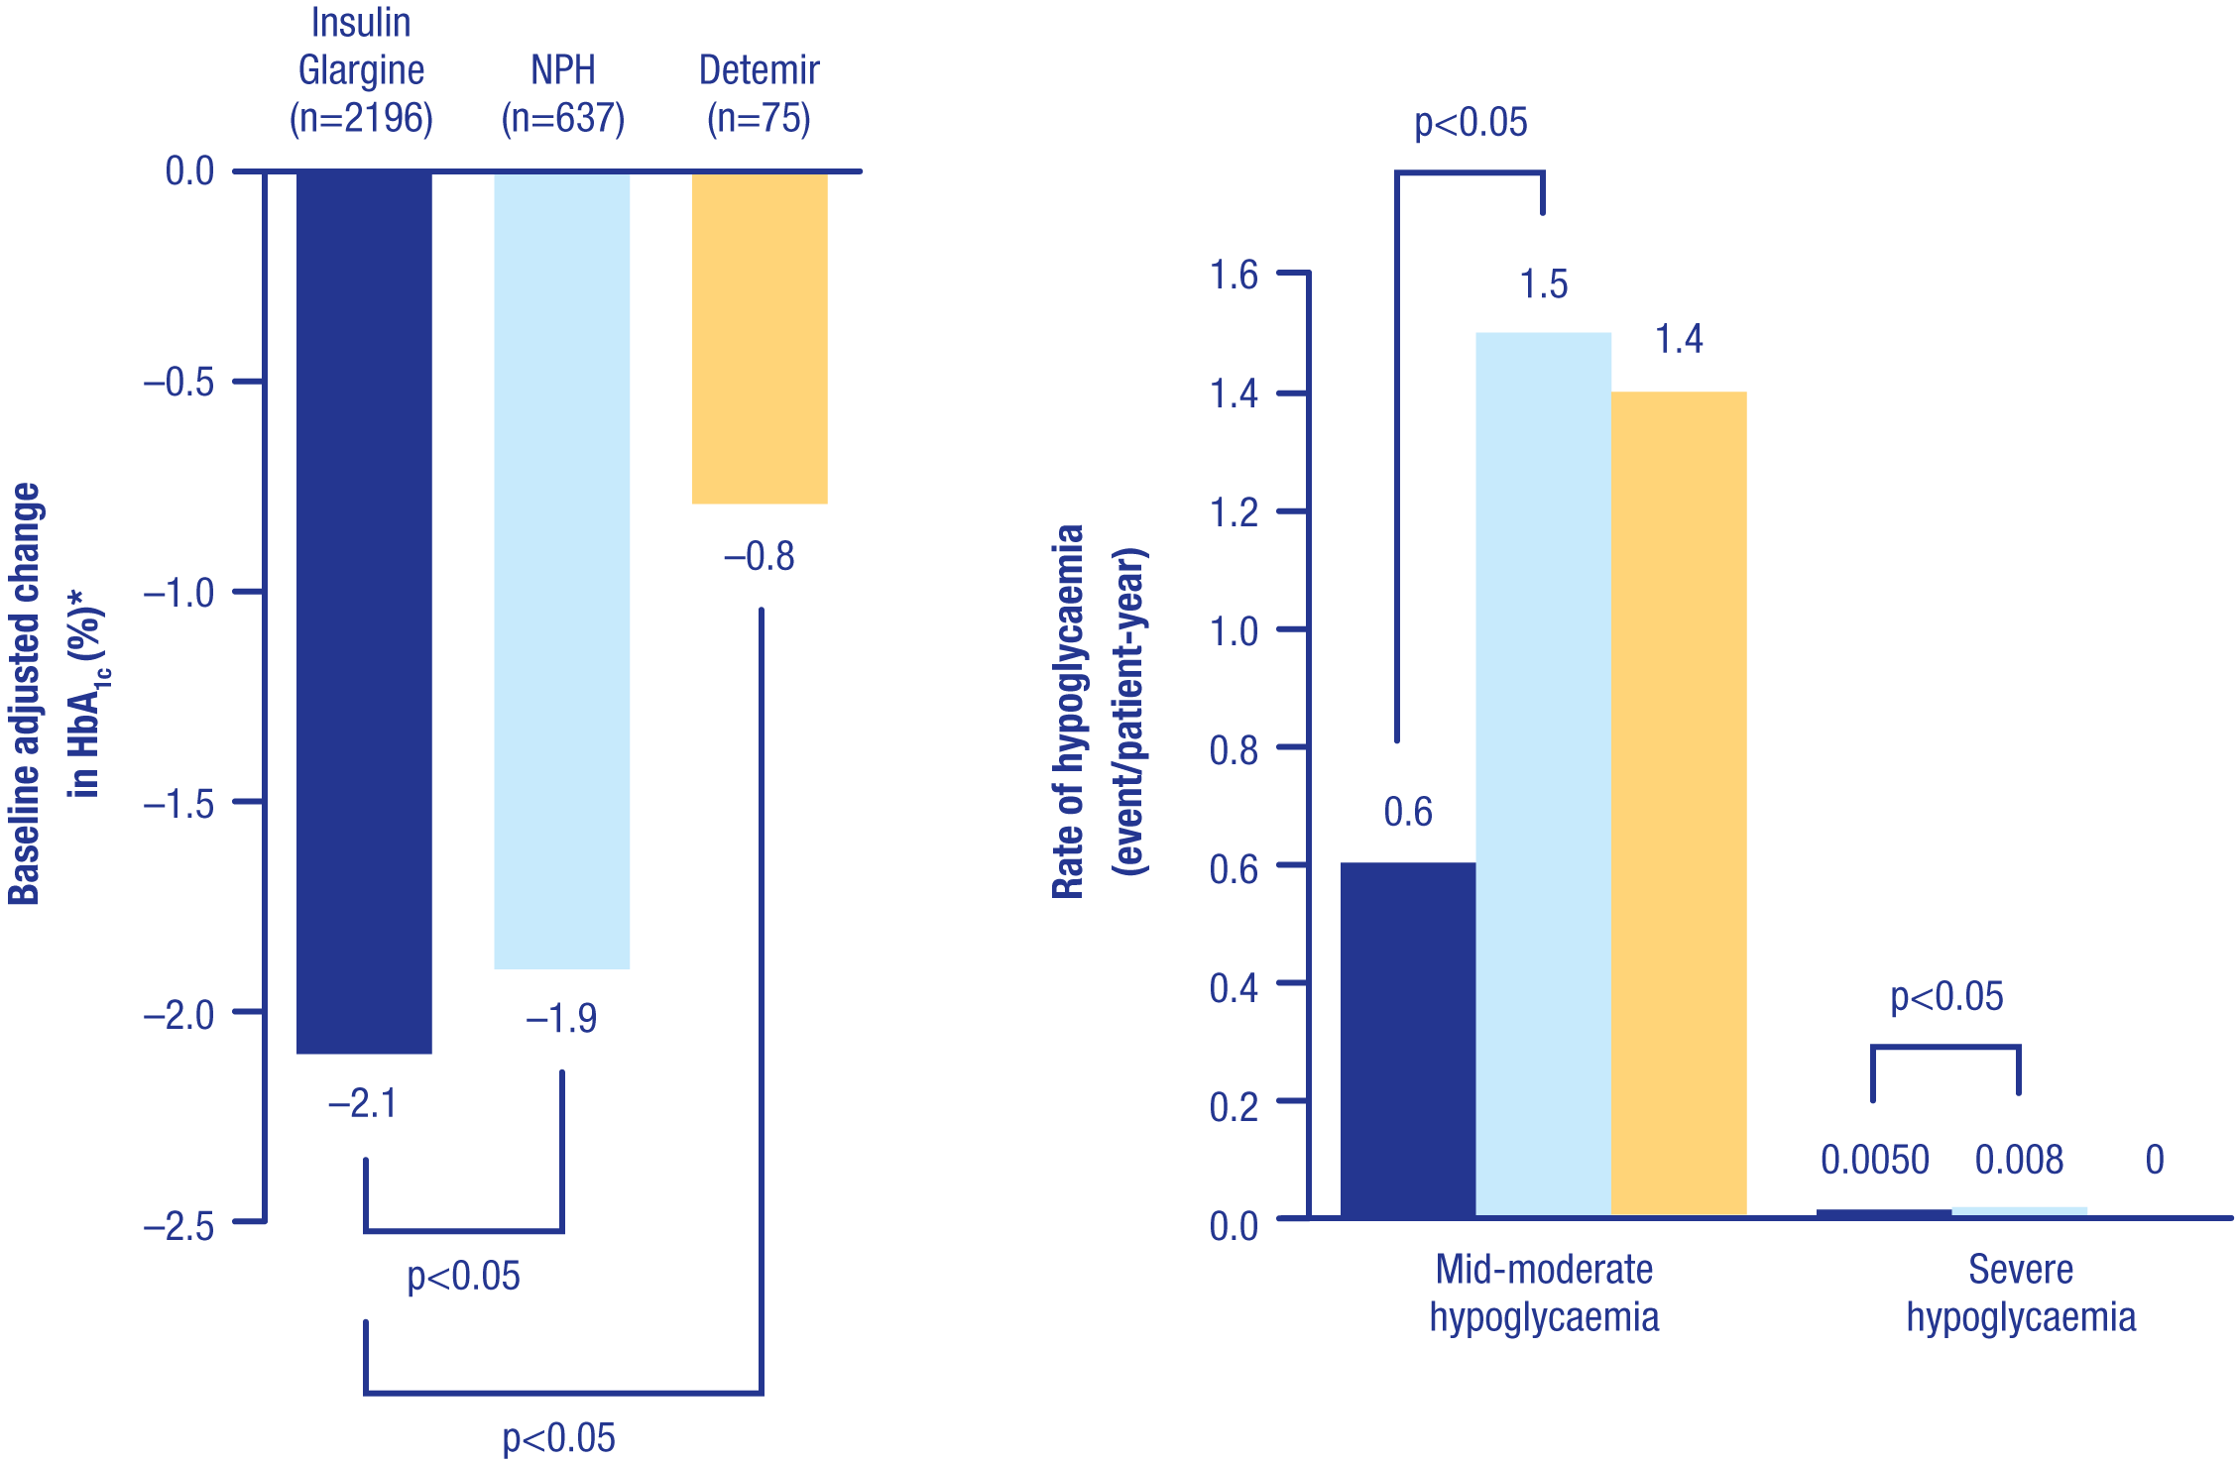
FINE Asia: Real world data 2015-
Insulin Glargine has better HbA_{1c} control and less hypoglycaemia versus NPH and detemir at initiation in Asian patients with T2DM
6-month observational study assessing the initiation of basal insulin in 2921 insulin-naïve Asian patients with T2DM who had poor glycaemic control using OADs
Diab Therapy 2015
Notes:
Description
FINE Asia is a multinational, prospective observational study in 11 Asian countries, evaluating the efficacy and safety of initiating basal insulin in 2921 insulin-naïve Asian patients with uncontrolled T2DM HbA_{1c} ≥8% on OAD therapy
Patients were treated with Insulin Glargine (n=2196), NPH (n=637) or detemir (n=75), with all treatment determined by the physician
Among all patients, HbA_{1c} was reduced from 9.8 ± 1.6 to 7.7 ± 1.4% at Month 6 following the initiation of basal insulin, with 33.7% of patient reaching HbA_{1c} <7%. Similarly, FBG decreased from 11.7 to 7.2 mmol/L (211.3 to 129.9 mg/dL) at Month 6, with 36.5% of patients reaching FBG <6.1 mmol/L (<110 mg/dL)
Insulin Glargine provided better glycaemic control (change in HbA_{1c} adjusted for baseline) at Month 6 (–2.1%) than did NPH (–1.9%; p<0.05) or detemir (–0.8%; p<0.05; p<0.001 for overall comparison)
Insulin Glargine and NPH patients exhibited some weight gain (+0.4 and +0.7 kg, respectively), whereas patients using detemir observed a decrease in weight (–0.4 kg; p=0.0276 for overall comparison)
Although overall hypoglycaemia rates were low, with 13.2 and 0.3% of patients experiencing mild/moderate and severe episodes, respectively, Insulin Glargine was associated with significantly lower incidences of mild/moderate and severe hypoglycaemia rates than NPH (both p<0.05)
More physicians and patients rated Insulin Glargine as good/very good (76/80%) versus NPH (57/67%) and detemir (40/48%)
Initiation of insulin treatment with basal insulin was efficient and safe in Asian patients with T2DM, with significant differences found among basal insulins
Study summary
Aim: To assess the efficacy of the first use of basal insulin in insulin-naïve T2DM patients in Asia
Study design: 6-month, multinational (11 countries), prospective, observational study
Outcomes
Primary: HbA_{1c} change 6 months after receiving insulin
Population: 2921 insulin-naïve patients with T2DM
Treatment received: Patients started insulin therapy with either Insulin Glargine (n=2196), NPH (n=636) or detemir (n=75) based on physicians’ decisions
References
Tsai ST. Evaluation of first insulinization by administration of basal insulin in Asian patients (pts) with type 2 diabetes (T2D). ADA 2009, abstract accepted

Slide 17
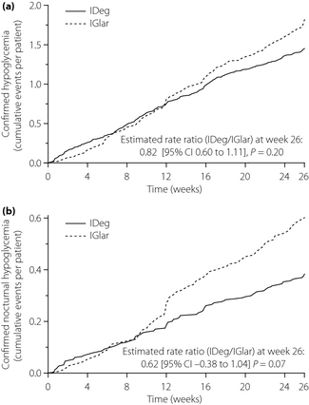
Insulin Degludec vs. Insulin Glargine
(BEGIN Once Asia)
435 insulin-naïve patients with T2DM in Asia
Cumulative hypoglycemic events confirmed <3.1 mmol/L
18% lower
with degludec
p=0.11
Glargine
Anytime
events/pt
Degludec
38% lower
with degludec
p=0.07
Glargine
Nocturnal
events/pt
Degludec
Difference
after 12 wk
  Onishi Y et al. J Diab Invest 2013;4:605-12.

Slide 18
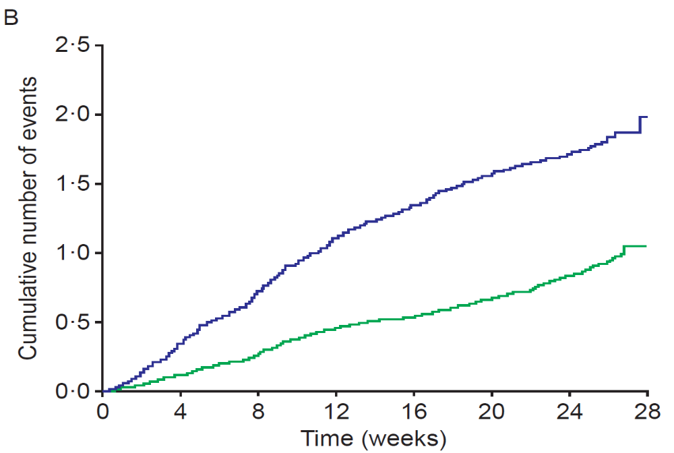
Insulin Glargine U-300 vs. U-100
(EDITION-2)
811 basal insulin using patients with T2DM
Cumulative mean number of nocturnal
severe or confirmed (≤3.9 mmol/L) events/participant
48% lower
with U-300
p=0.001
Difference mostly
up to 12 wk
  Yki-Jarvinen H et al. Diabetes Care 2014;37:3235-43.

Slide 19
Per Unit cost (Rs.)
Insulin | Penfill | Prefilled pen
Glargine U – 100 (Lantus) | 2 | 3.4
Glargine U – 300 (Toujeo) | - | 3.7
Degludec (Tresiba) | 4.8 | 6.2

Slide 20
Slow Up-titration

Slide 21
Selecting the right starting dose
While a total daily dose of insulin of
0.1 to 0.2 units/kg could be initially used in patients with a hemoglobin A1c level less than 8%,
0.2 to 0.3 units/kg is required if the hemoglobin A1c level is between 8% and 10%.
60 kg patient A1c 7.9%
Start with 10 – 12 units
60 kg patient A1c 9%
Start with 12 – 18 units
1. Cleveland Journal of Medicine 2015 August

Slide 22
Simpler titration algorithms are associated with lower incidence of hypoglycemia
Lower incidences of hypoglycemia were achieved for patients treated using simpler algorithms 1 and 2
Algorithm 1
p = 0.0018
p < 0.0001
Algorithm 2
Patients,%
Algorithm 3
p = 0.0009
57.6
p = 0.0337
51.8
p = 0.0008
40.8
30.1
28.0
22.0
23.5
13.3
7.3
Confirmed glucose
< 56 mg/dL (3.1 mmol)
Confirmed glucose
< 70 mg/dL (3.9 mmol)
Nocturnal confirmed
glucose < 56 mg/dL (3.1 mmol)
Algorithm 1: 1 IU increase once daily, if fasting plasma glucose [FPG] > target
Algorithm 2: 2 IU increase every 3 days, if FPG > target
Algorithm 3: treat-to-target, generally 2–8 IU increase weekly based on 2-day mean FPG levels
Target FPG ≤100 mg/dL
Dailey G, et al. J Diabetes 2014; 6:176-83.

Slide 23
ATLAS titration algorithm
Simple algorithms are easy for patients to use
Fasting Blood Glucose
Insulin Dose
mg/dL
mmol/L
Dose decrease at
physician’s
FP
G ≤ 56
FP
G ≤3.1
discretion and
upon physician’s
clinical judgment
≤ 70 or symptomatic
≤ 3.9 or symptomatic
-
2 U
hypoglycemia
hypoglycemia
70 < FP
G ≤110
3.9 < FP
G ≤ 6.1
No change
110 < FP
G ≤ 1
6
0
6.1 < FP
G ≤
8.9
+ 2 U
FP
G > 1
6
0
FP
G >
8.9
+ 4 U
Patient-led : insulin dose titrated every 3 days
Usual care : titration to occur at each physician visit
Garg S et al. Endocrine Practice February 2015, Vol. 21, No. 2, pp. 143-157
Notes:
The titration regimens for each arm are as follows:
Arm A: Usual standard of care group (titration at every visit, managed by physician)
Patient will be reviewed by the physician at every visit, either in person or over the telephone. The middle value of the last 3 consecutive FPBG values will be used to perform the titration.
Arm B: Intervention group (titration every 3 days, managed by subject)
Patient will be empowered to adjust their insulin doses, under strict investigator’s supervision.
Titration scheme: patients will use the middle value of their last 3 consecutive FPG values to perform the titration. They will titrate their insulin dose every 3 days.

Slide 24
ATLAS : India subgroup: Change in A1c
Figure 2. Change in HbA1c from baseline to week 24
A substantial decrease in HbA1c relative to baseline was observed in both treatment arms as early as week 12
The decrease in HbA1c from baseline to 24 weeks was greater in patient-led group than in the physician-led group (-1.34% vs. -1.14%)
Garg S et al. Endocrine Practice February 2015, Vol. 21, No. 2, pp. 143-157

Slide 25
My Algorithm
FBS | Basal Insulin Dose (units)
> 150 | + 4
130 – 150 | + 2
100 – 130 | same
80 – 100 | – 2
< 80 | – 4

Slide 26
Inappropriate Insulin Therapy

Slide 27
Hypoglycaemia, weight gain and daily
dose all lower with glargine vs premix
Hypoglycaemia
Weight gain
Daily insulin dose
30
28
p = 0.007
4
3,6
p < 0.0001
0,6
p < 0.001
23
0,5
0,47
3
0,40
20
2,5
0,4
kg
At study end (U/kg/day)
Episodes per patient year
2
0,3
10
0,2
1
0,1
0
0
0
Premixed
Insulin
Premixed
Insulin
Premixed
Insulin
Insulin
lispro
glargine
Insulin
lispro
glargine
Insulin
lispro
glargine
Buse J, et al. Diabetes Care 32:1007–1013, 2009.

Slide 28
The type of insulin can influence persistence with therapy
Database study of persistence with basal or premix as first insulin after becoming uncontrolled on oral glucose lowering therapy
100
100
80
80
Basal (glargine)
60
56
60
Persistent (%)
45
Premix
Persistent (%)
40
40
Log rank p<0.001
20
20
0
0
Premix
insulin
Basal
(glargine)
0
60
120
180
240
300
Days of follow up
Persistence was defined as remaining on treatment (prescription refilled within the expected time) during the follow-up period, without discontinuation or switching after initiation
Basur O et al et al. Clinicoecon Outcomes Res 2013;5:497-505.

Slide 29
Recognizing When Basal Insulin Is
Not Enough
In-range fasting plasma glucose with one or both:
  Persistently elevated post-prandial glucose (>180 mg/dL).
  A1c above target.
Average type 2 DM patient requires ≈ 0.5 units/kg basal insulin.
  Higher doses (>0.5 units/kg) strongly suggest need for mealtime insulins.
Further increases in basal insulin cause daytime or nighttime hypoglycemia.

Slide 30
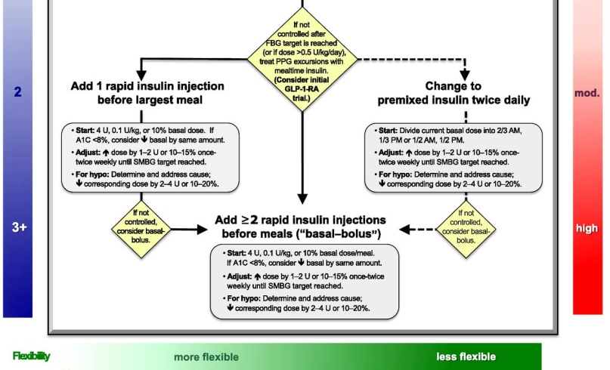
What is the next step after basal insulin? 2 options
Add
Rapid acting insulin
Add
Premix
insulin
Alternative as moderate complexity and lower flexibity
In select cases
Preferred as moderate complexity and higher
flexibity
Diabetes Care 2015;38:140-149; Diabetologia 2015;58:429-442

Slide 31
Previous Case
Rx
Inj.Glargine 16 units daily
Carb intake reduced
Tab.Acarbose (25 mg) 1-1-1
> 1 month
FBS – 105
PPBS – 172

Slide 32
How to Intensify Insulin Therapy

Slide 33
Case 3
64 yrs/F
Uncontrolled DM
BBF | 116
ABF | 178
BL | 166
AL | 320
BD | 228
AD | 260

Slide 34
Current Rx
Metformin 2 gm/day
Glimiperide 4 mg/day
Acrabose 25 mg TDS
Glargine 28 units/day

Slide 35
What Next ?
Dietary modification
Acarbose 50 mg TDS
DPP4i
SGLT2i
GLP1 agonist
Bolus Insulin: Regular/Lispro/Aspart/Glulisine

Slide 36
What Next ?
Dietary modification
Acarbose 50 mg TDS
DPP4i
SGLT2i
GLP1 agonist
Bolus Insulin: Regular/Lispro/Aspart/Glulisine

Slide 37
How to start Bolus Insulin ?

Slide 38
Case 3
64 yrs/F
Uncontrolled DM
 |  | PP excursion
BBF | 116
ABF | 178 | 62
BL | 166
AL | 320 | 154
BD | 228
AD | 300 | 72

Slide 39
Basal Plus
Basal + 1 Bolus
Bolus:
Largest meal (highest PPBS)

Slide 40
Basal Plus
Regular Insulin
6 units BL
Diet modification
BBF | 112
ABF | 162
BL | 138
AL | 157
BD | 126
AD | 174

Slide 41
> 6 months
 |  | PP excursion
BBF | 108
ABF | 214 | 106
BL | 186
AL | 204 | 18
BD | 192
AD | 316 | 124

Slide 42
Basal Bolus
Basal + 2/3 bolus
Regular Insulin
4 – 6 – 4

Slide 43
> 5 days
 |  | PP excursion
BBF | 94
ABF | 142 | 48
BL | 146
AL | 166 | 20
BD | 138
AD | 172 | 34

Slide 44
Conclusion
Timely Initiation of Insulin: must
Proper titration based on SMBG
Intensify insulin therapy as & when needed

Slide 45



Slide 46
Common mistakes while ordering Endocrine Investigations

Slide 47
Pheochromocytoma
24 hour urine VMA
24 hour urine Metanephrines
Plasma Metanephrines
Plasma Free Normetanephrines

Slide 48
Addision Disease
S.Cortisol
Plasma ACTH,
S.Na, S.K
PRA,

Slide 49
Cushing’s Disease
S.Cortisol
Dexa suppressed Cortisol

Slide 50
Hyperthyroid
TSH
T3, T4,
TSH

Slide 51
38 yrs/F
Grave’s disease
Rx.Carbimazole 20 mg/day
TSH – Low
 | Pt’s | Normal Range
TSH | 0.001 | 0.4 – 4
T3 | 40 | 60 – 200
T4 | 2.8 | 4.5 –12.5

Slide 52
Hyerparathyroidism
PTH
S.Calcium, S.Albumin,
S.Phosphorous, ALP,
Vitamin D
PTH

Slide 53
62 yrs/F
Femur neck fracture
PTH – High
 | Pt’s | Normal Range
PTH | 184 | 15 – 60
Vit D | 4 | 30 – 100
Calcium | 8.4 | 8.5 – 10

Slide 54
Acromegaly
GH
IGF1

Slide 55
Hyperaldosteronism
Aldosterone
PRA
Plasma Aldosterone

Slide 56
Case 1
24 yrs/M
Tingling, numbness in extremities
Ionised calcium – high
Referred for Hypercalcemia/Hyperparathyroidism

Slide 57
 | Pt’s | Normal Range
S.Calcium | 7.4 | 8.5 – 10
S,Phosphorous | 6.0 | 2.5 – 4.5
PTH | 4 | 10 – 65
Hypoparathyroidism

Slide 58
Case 2
26 yrs/F
Epilepsy
Free T3 – Normal
Free T4 – High
TSH – Normal
No toxic symptoms

Slide 59
Reason ?
 | Pt’s | Normal Range
T3 | 100 | 60 – 200
T4 | 6.5 | 4.5 – 12.5
TSH | 4 | 0.5 – 5

